Slide 1

Intelligent Water Systems
Xylem Vue powered by GoAigua
JAN 2025

Slide 2

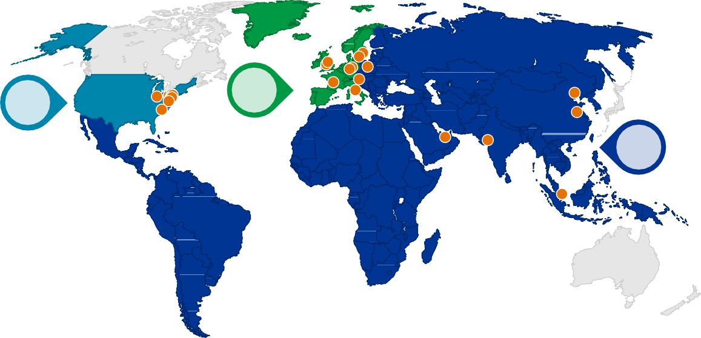

Xylem Snapshot (NYSE: XYL)
Key Statistics
Expansive Geographic Footprint
Founded | 2011
Headquarters | Washington DC
India Headquarter | Bangalore
Global Locations | ~375
Total Employees | 22,000+(1000+ India)
Water Enabled for Reuse | 4.7 B m3
Pollution Prevention | 2.6 B m3
45%
25%
US
Western Europe
20%
Emerging Markets
10%
Rest of World
Significant Locations³
Revenue Profile
2022 Financials
5%
10%
30%
Utilities
Industrial
Commercial
Residential
Revenue | $7.3 B
40%
Water Infrastructure Applied Water M&CS
Segment
End Market
55%
30%
30%
30%
Seminar at Ahmedabad

Slide 3


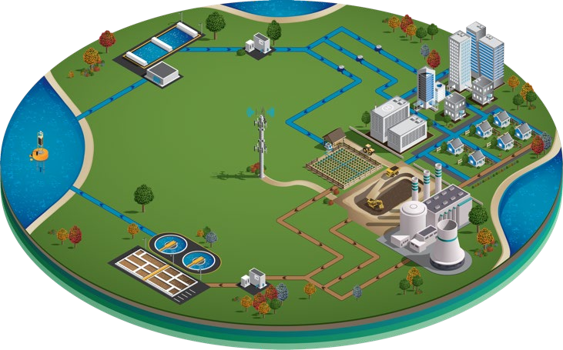



Comprehensive Solutions Across the Water Cycle
MEASUREMENT AND CONTROL SOLUTIONS
APPLIED WATER
WATER INFRASTRUCTURE

Slide 4
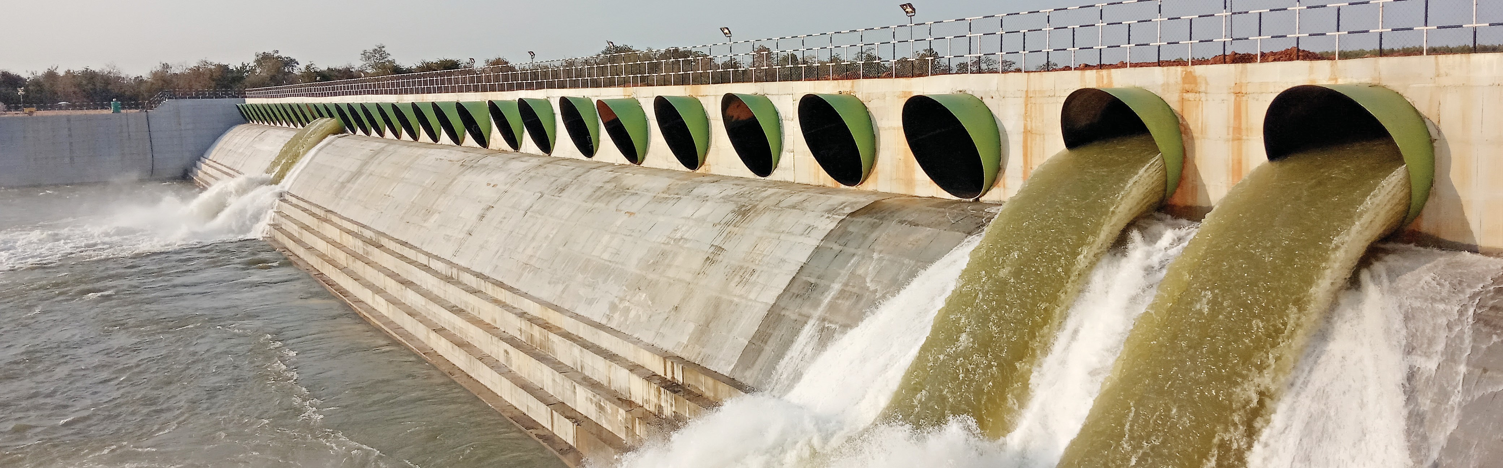
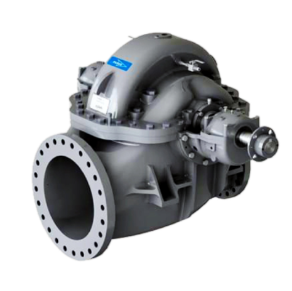
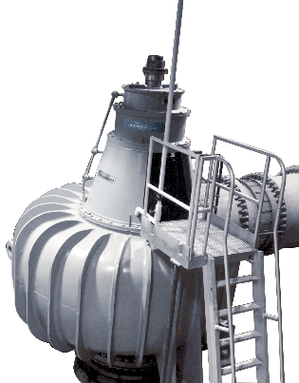
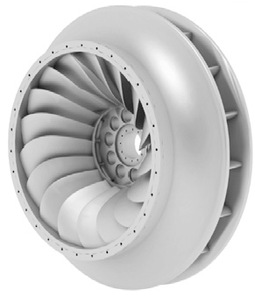
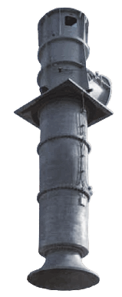
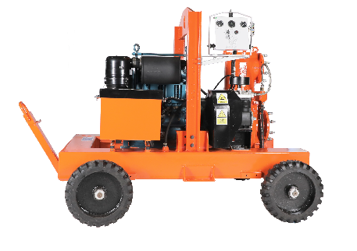
Water transport 1/2 | Water treatment | Measurement & Control | NRW reduction | Digital water
Kaleshwaram Lift Irrigation Scheme – 14 pumps (each capacity : 75000 liters/sec
Customized Pumps & Pumping Solutions for Transport of Water & Wastewater
Think New & Better
Trusted
Designed for energy efficiency, durability & sustainability with 150 years old legacy from Allis-Chalmers Co (U.S)
PARTNER IN
WATER TRANSPORT
Sector
Irrigation, River Development, Flood Control and Industries
Success stories
Sardar Sarovar Narmada Nigam Ltd, Kaleshwaram Lift Irrigation Scheme, Chintlapudi Lift Irrigation
Large Split-Case Pumps
Metallic Volute Pumps
Vertical Francis Turbine Pumps
Column Pumps
Dewatering Pumps

Slide 5
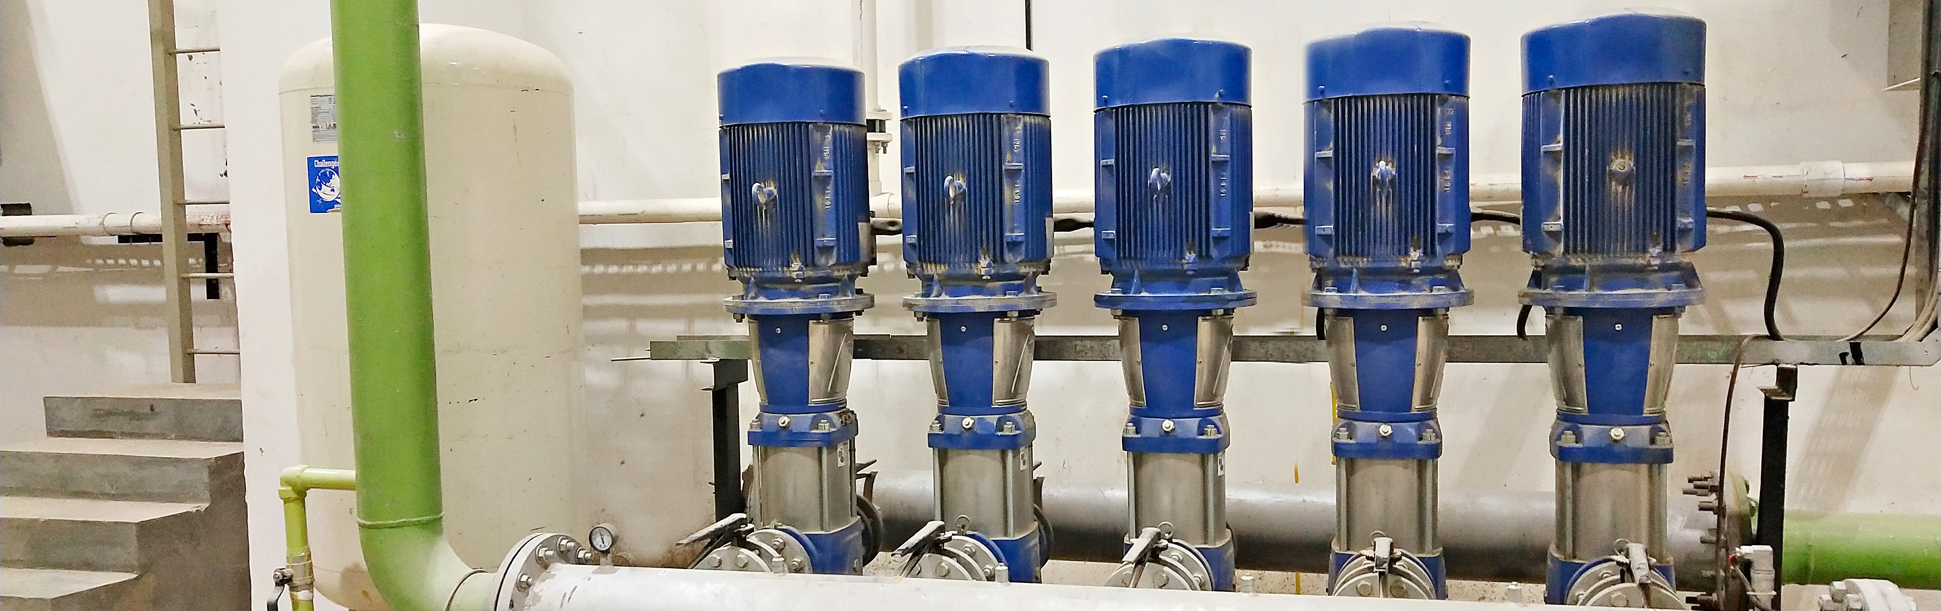
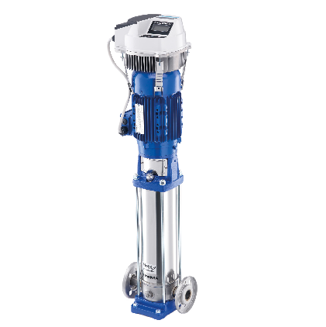
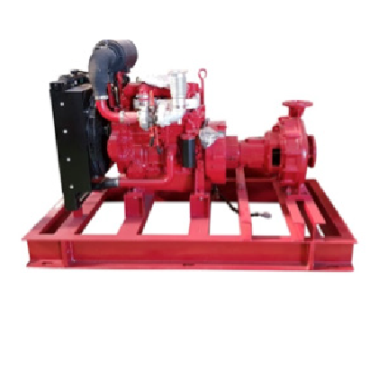
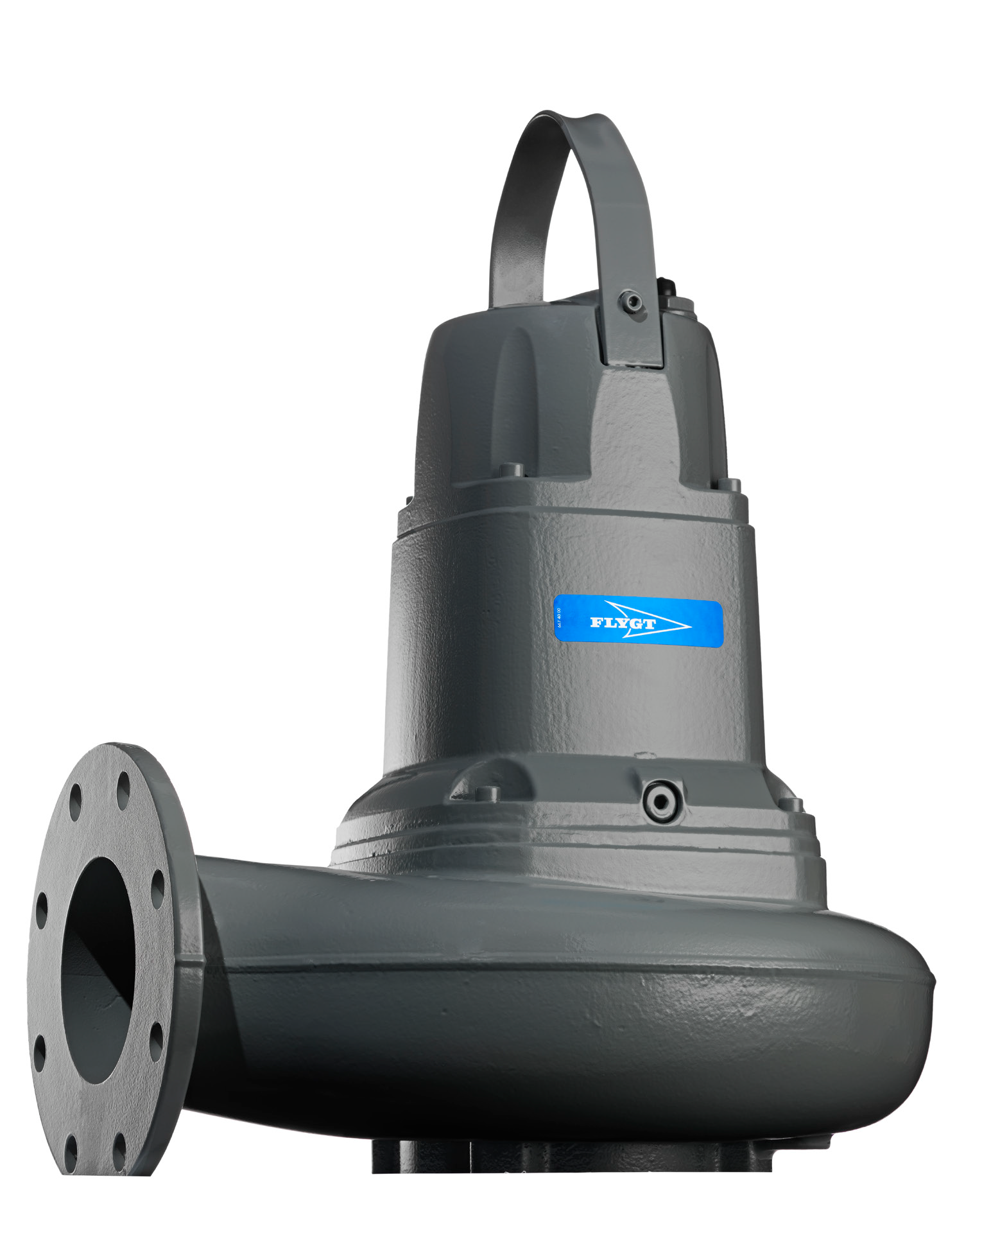
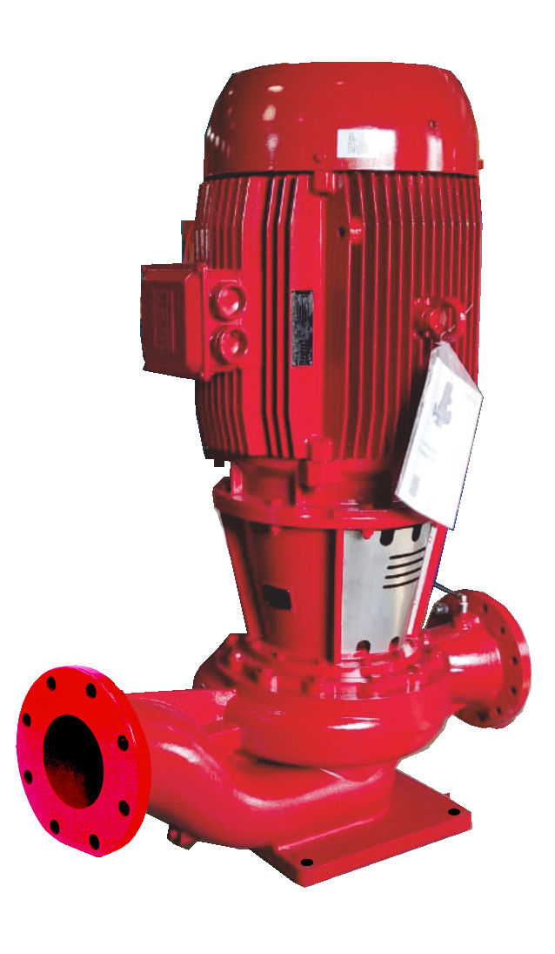
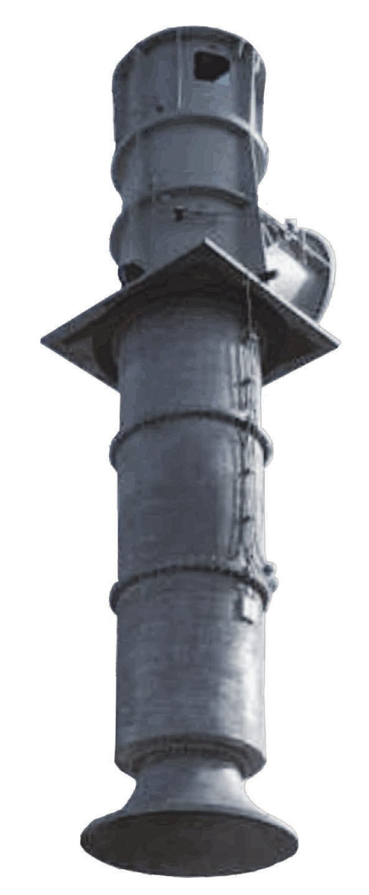
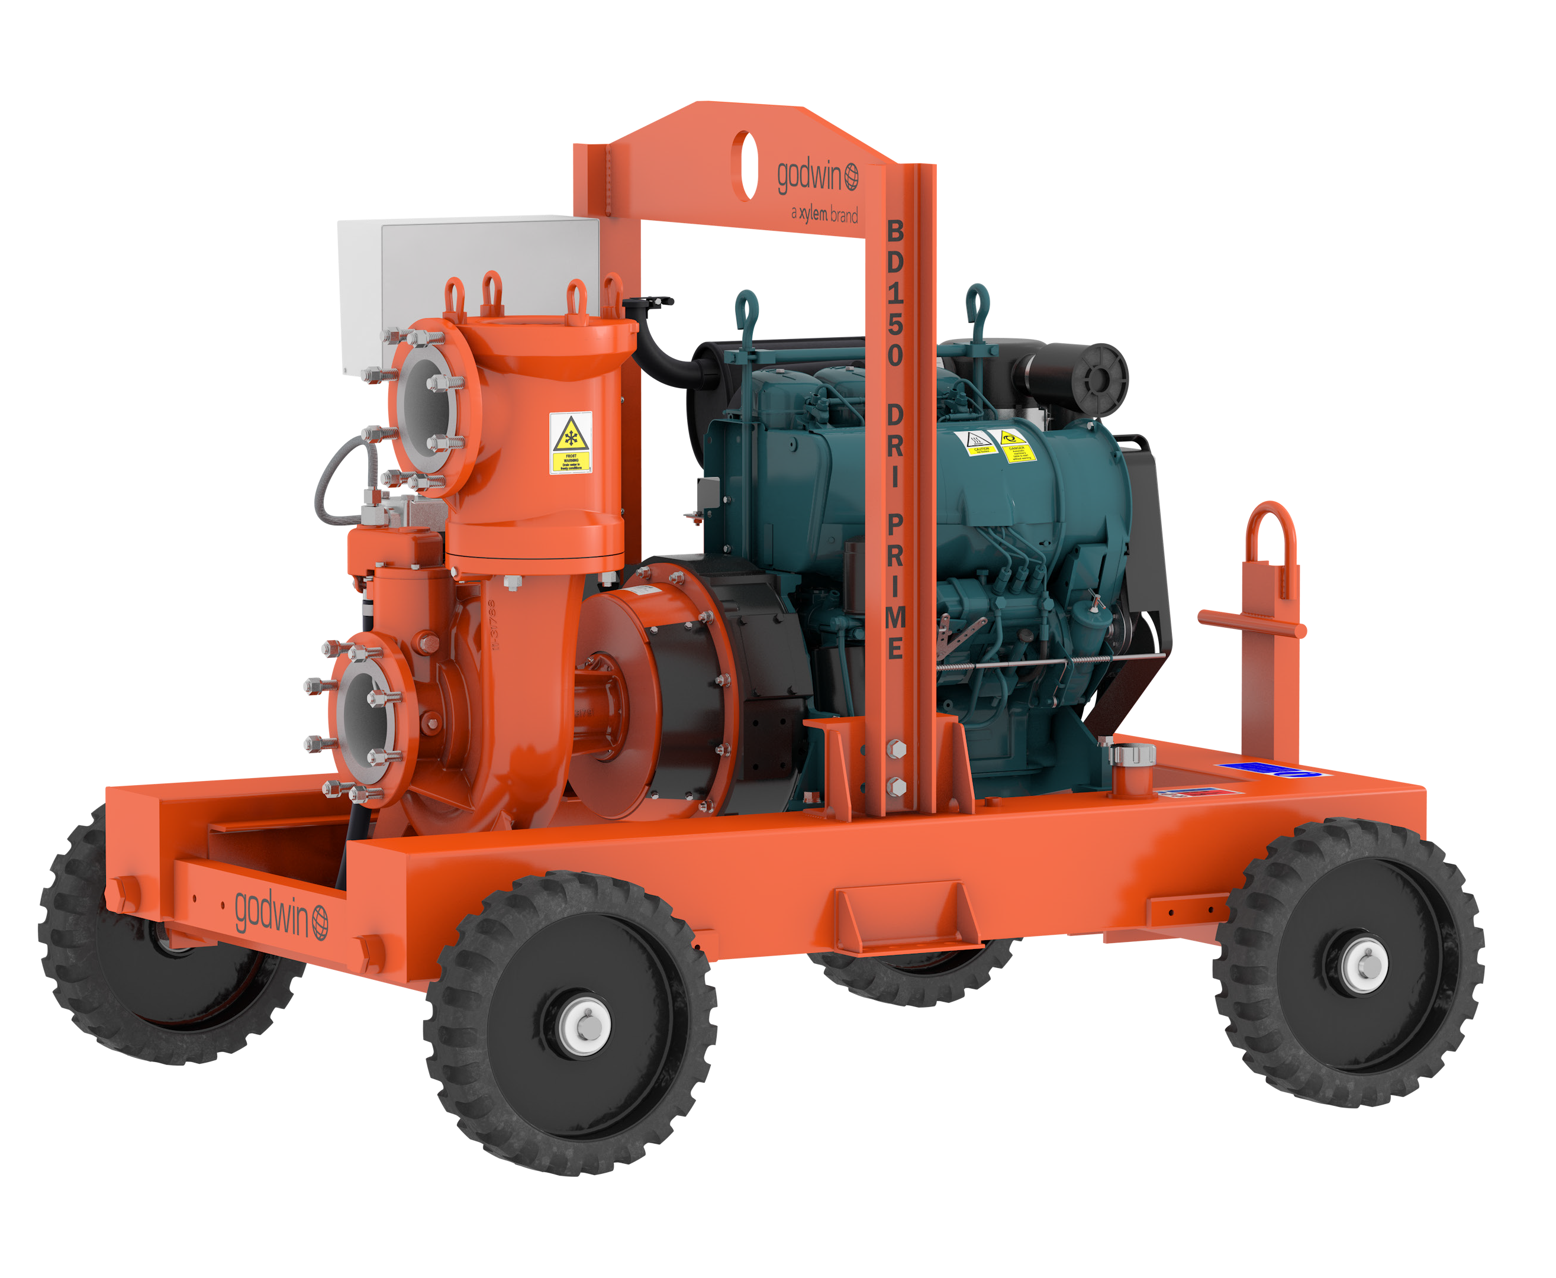
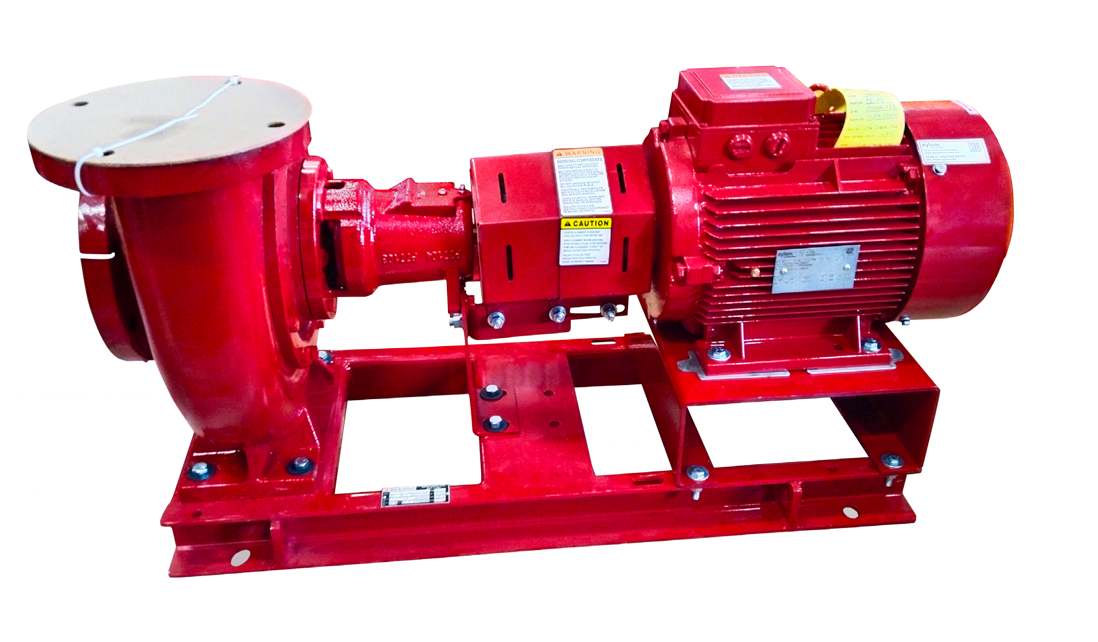
Water transport 2/2 | Water treatment | Measurement & Control | NRW reduction | Digital water
10,000+ Installations in India
Pumps & Pumping solutions for water transfer in commercial buildings, Industries.
Think New & Better
Trusted
Designed for efficiency, durability, performance and sustainability.
PARTNER IN
WATER TRANSFER
Sector
Commercial Building and Industries.
Success stories
Narendra Modi (Motera) Stadium, Central Vista New Delhi, MOPA Airport Goa, Statue of Unity Varodara, Kartarpur Corridor (HVAC Pumps), Rashtrapati Bhawan (HVAC Pumps), Vidhan Sabha (HVAC Pumps), Dwarka Convention Centre, LT Seawoods Maharashtra, Godrej BKC Maharashtra, Panchshil, Praj, Seabird, Bengaluru Metro, DJB Mehrauli.
End suction Pump
Multistage Pump
Fire Pump
Submersible Pump Inline Pump Vertical column Pump Dewatering Pump

Slide 6
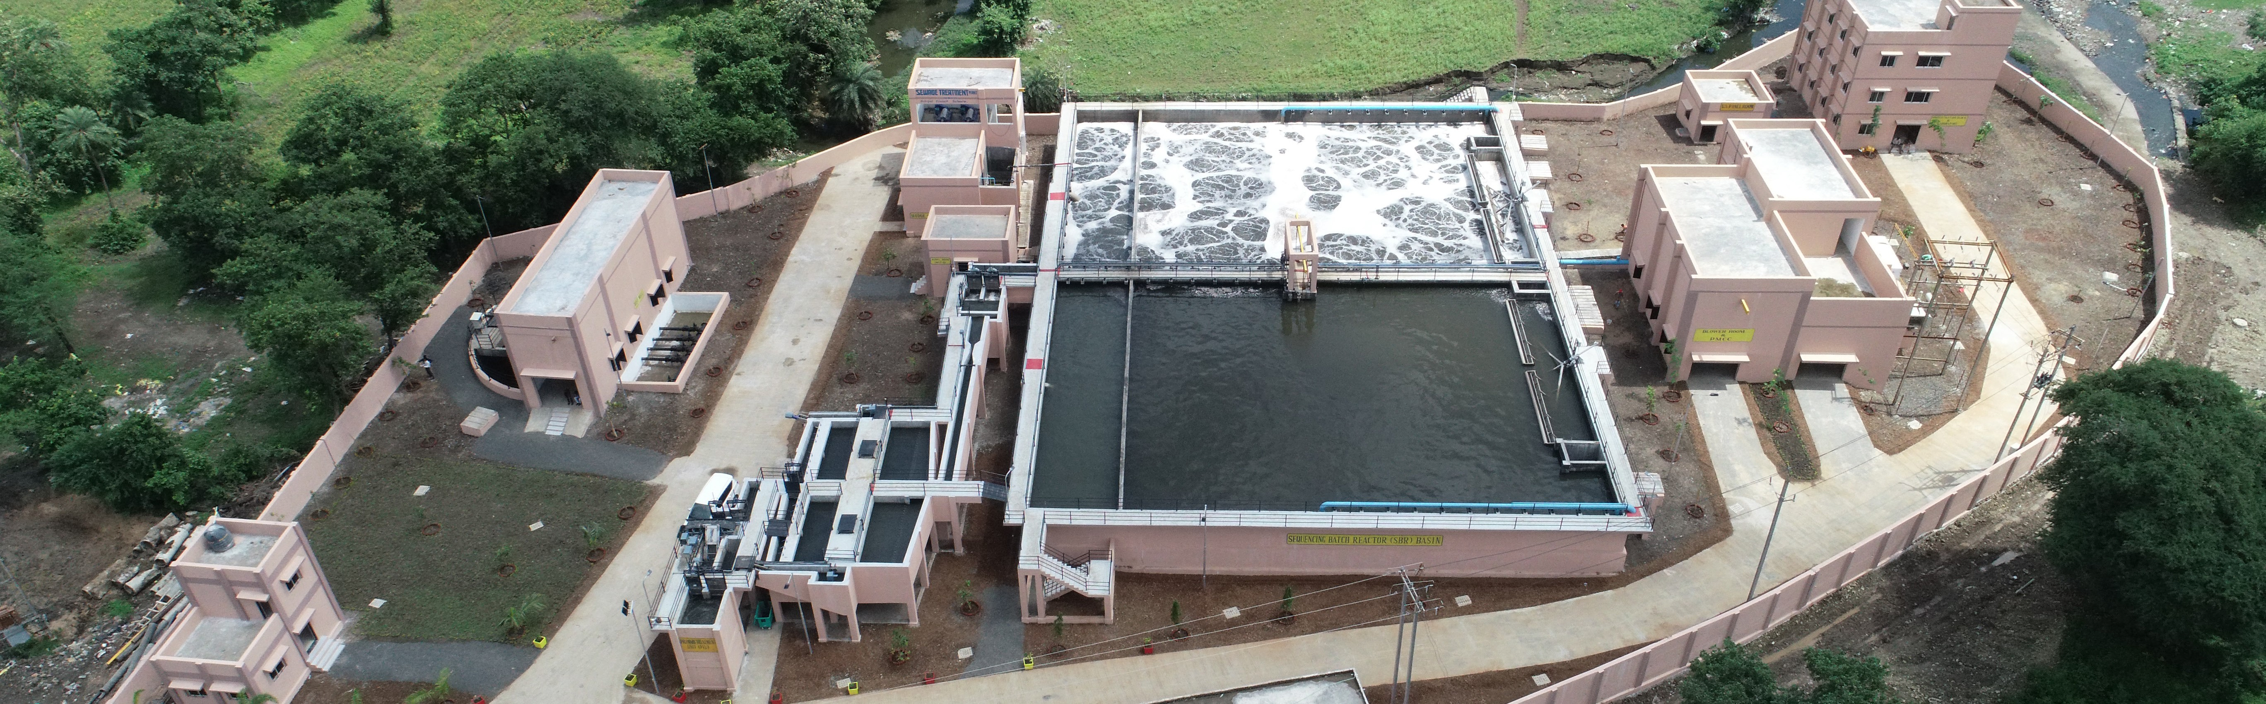
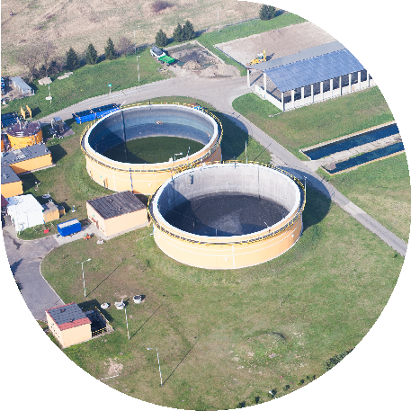
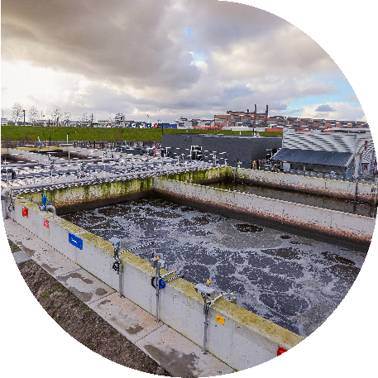
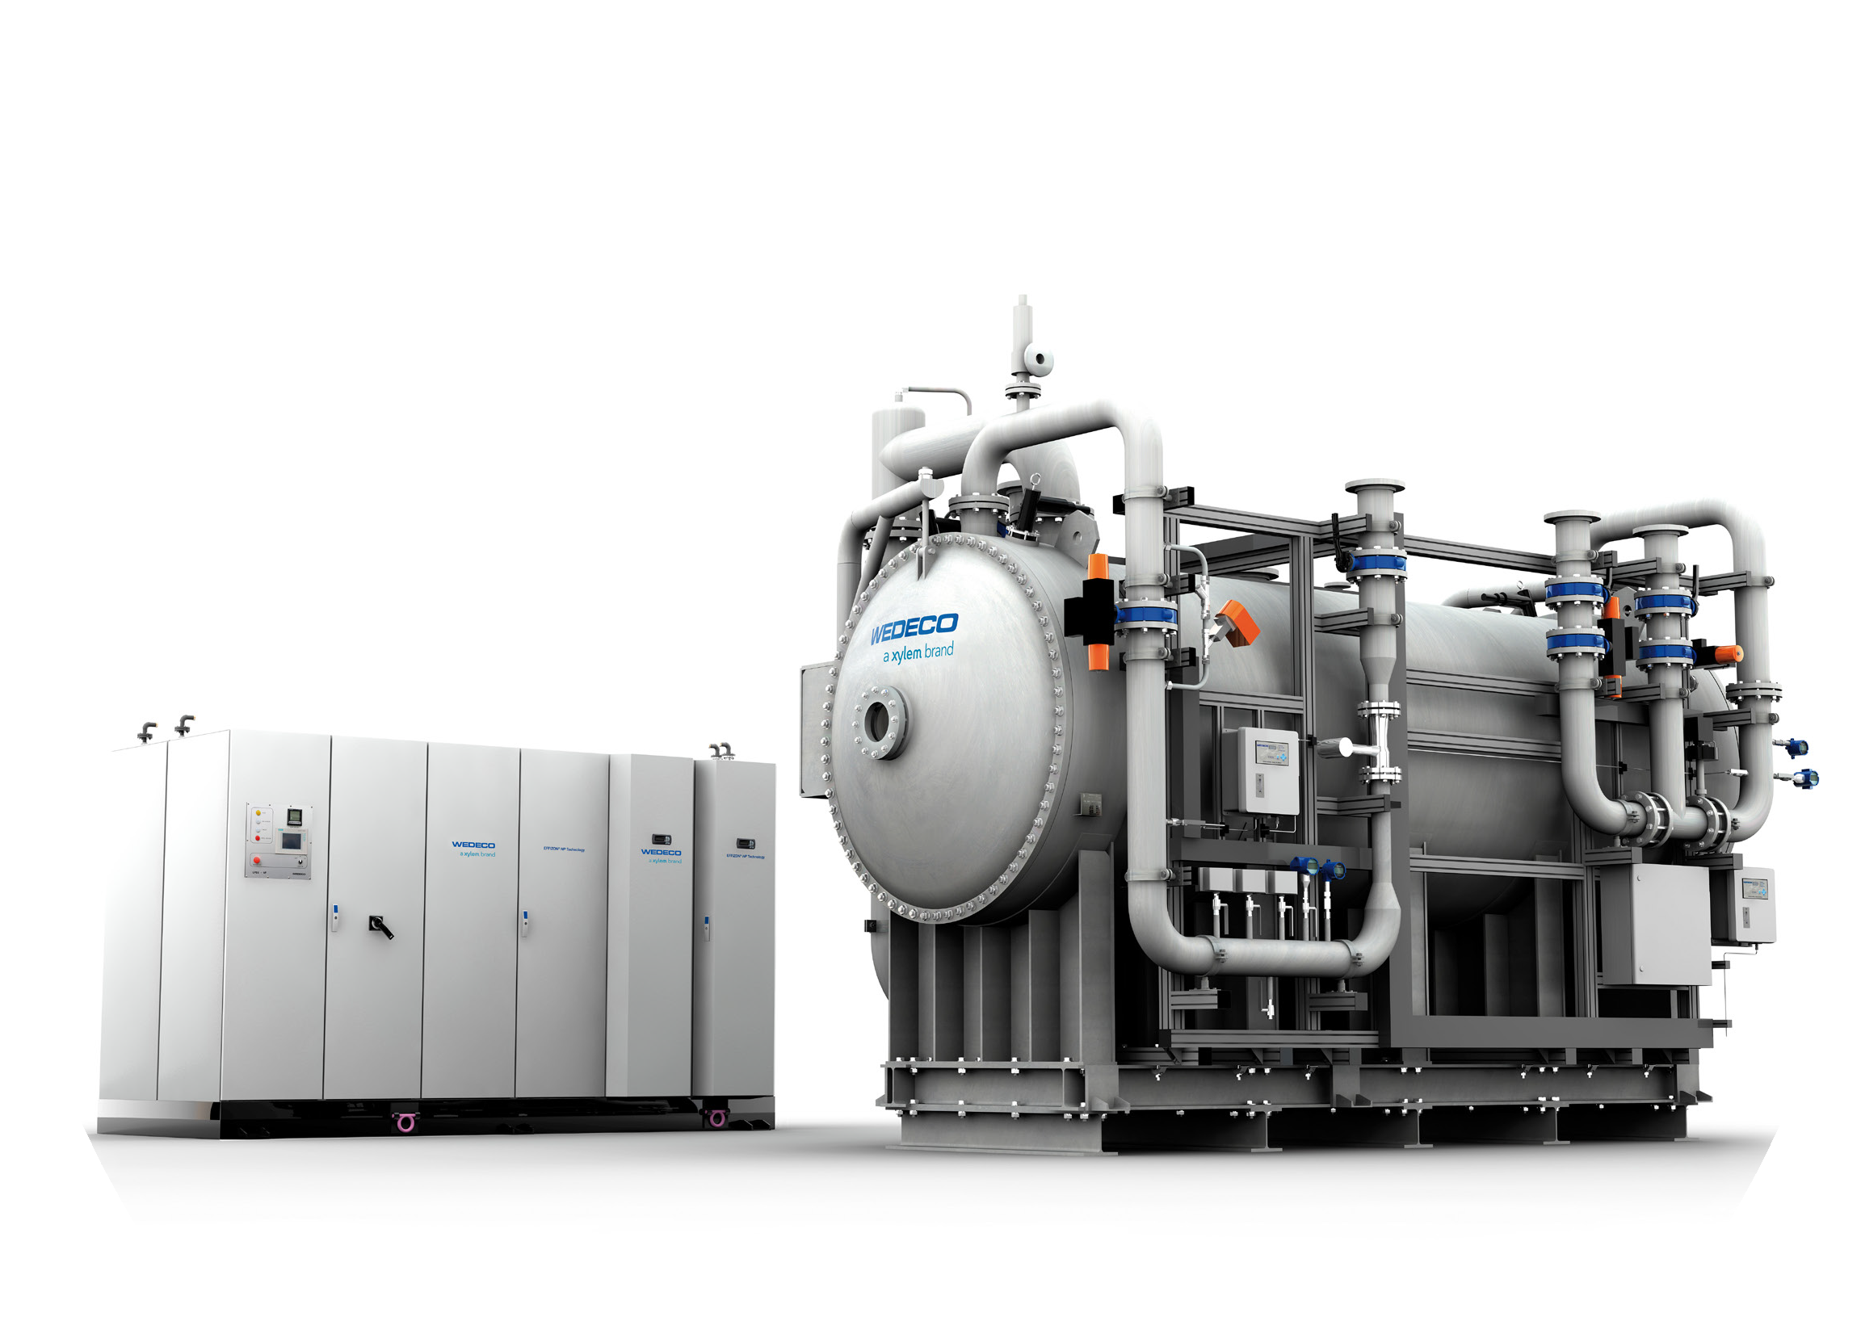
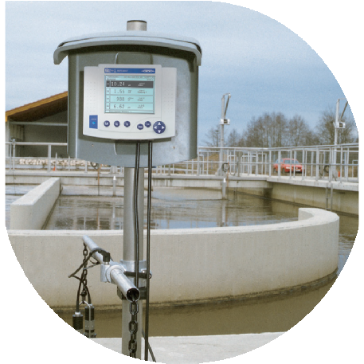
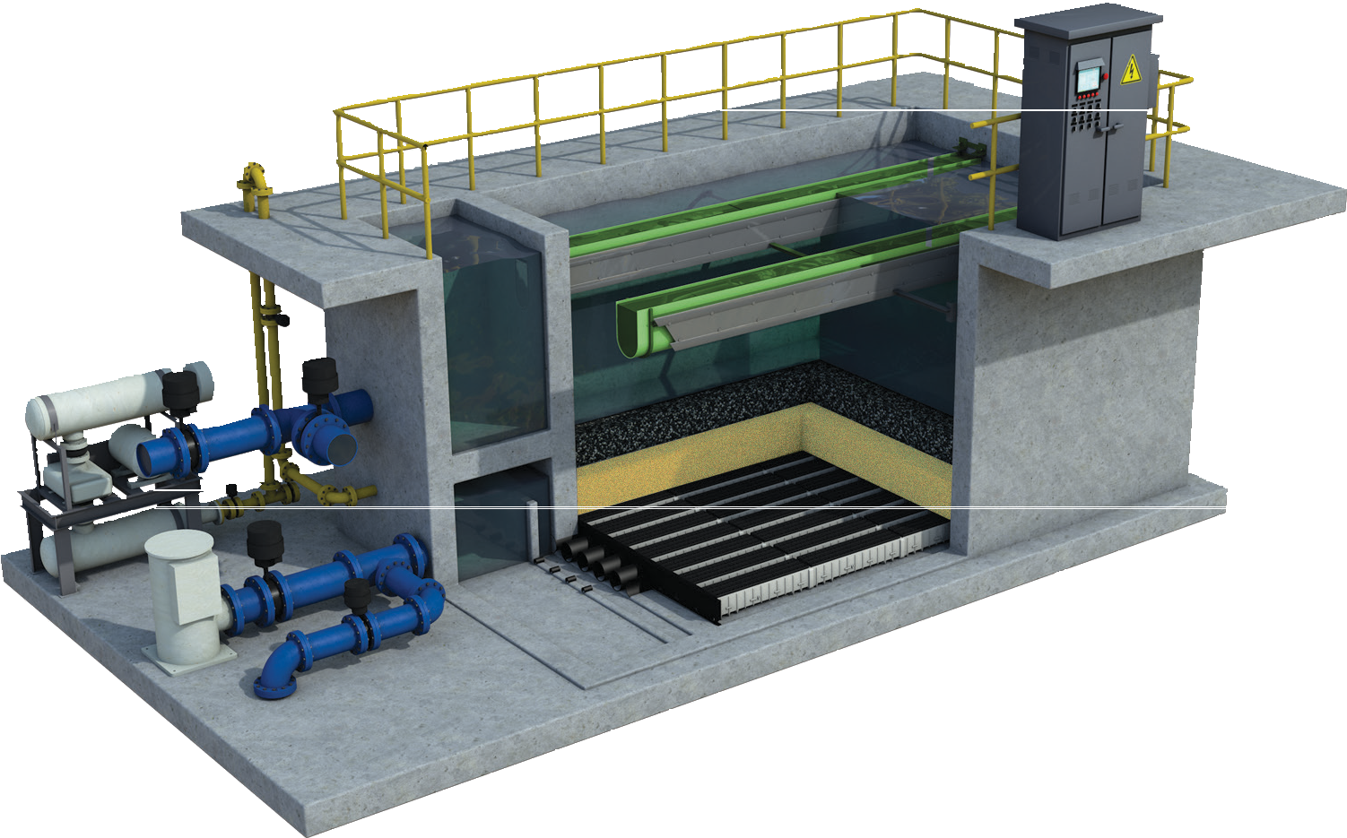
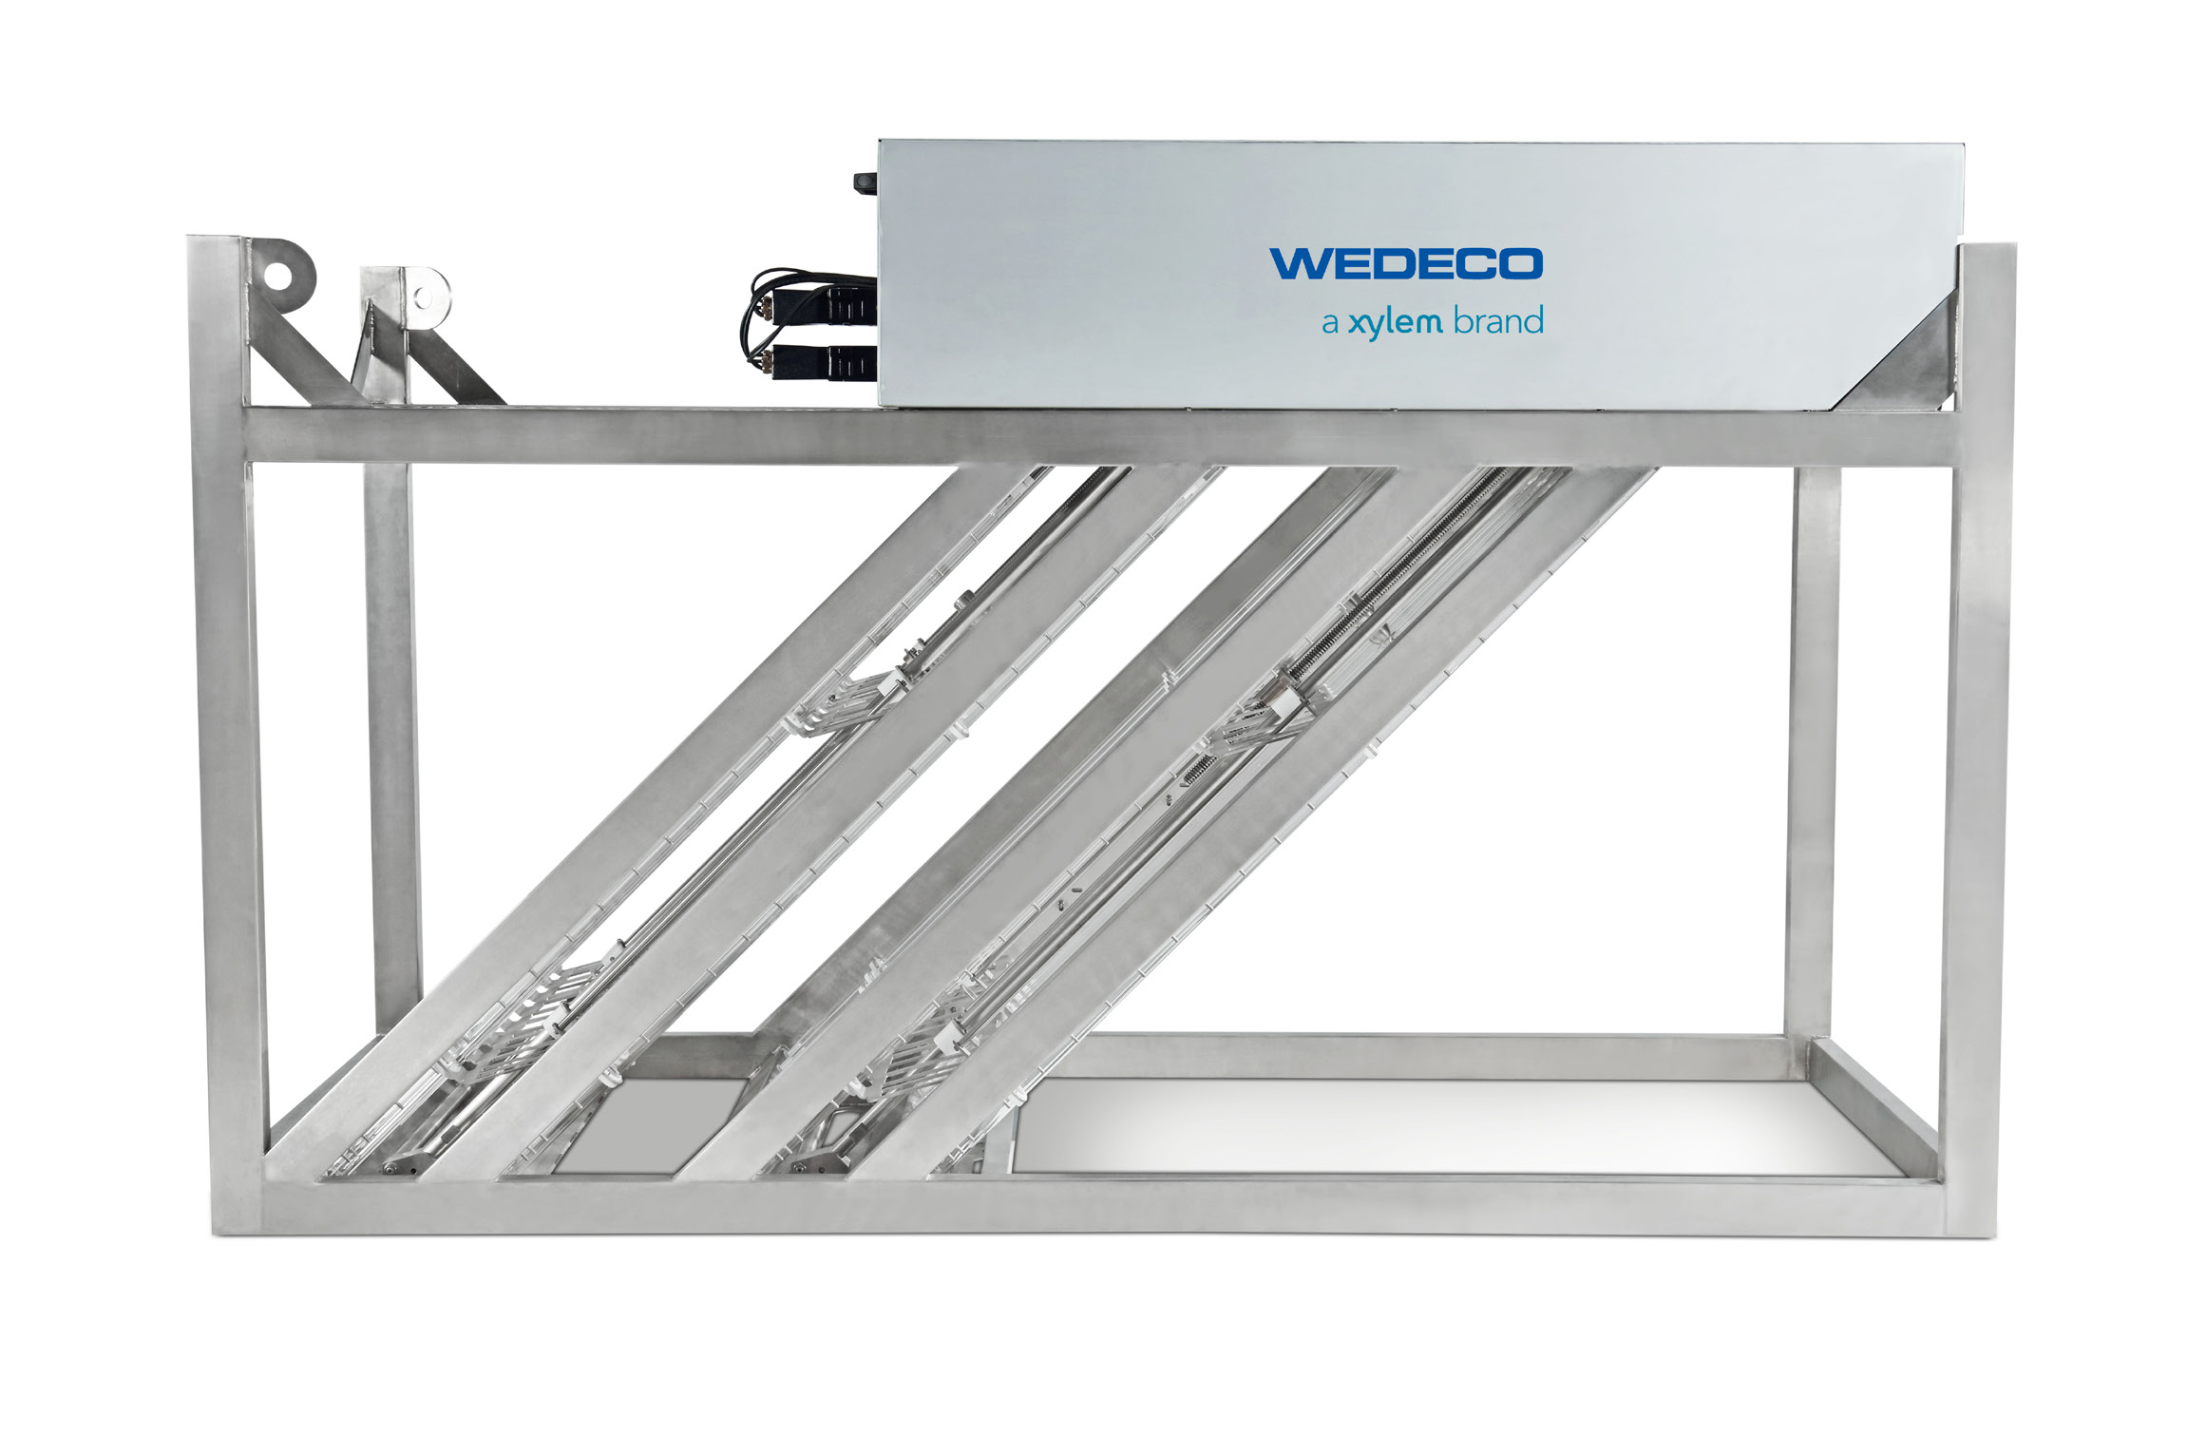
Water transport | Water treatment | Measurement & Control | NRW reduction | Digital water
12 MLD SBR based STP at Sehore, Madhya Pradesh
Advanced SBR, STP retrofit, diffusers, mixers, UV, and ozone systems
Think Sustainability
Trusted
Designed to meet your water sustainability goals & adherence to environmental norms
PARTNER IN WATER & WASTEWATER
TREATMENT/RECYCLE
Sector
Municipal & Industrial
Success stories
> 50 large STPs in India, 12 MLD Sehore STP, 70 MLD Jamnagar STP, UV at Rashtrapati Bhawan, Ozone plant at ITC
Filtration System
STP Retrofit Technology
Biological Treatment (Advanced SBR)
UV System
Ozone System
Monitors & Sensors

Slide 7
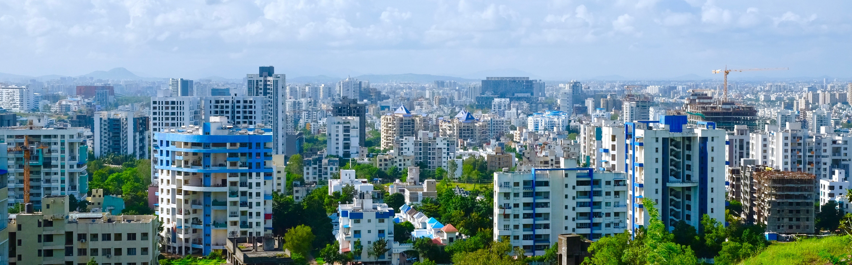
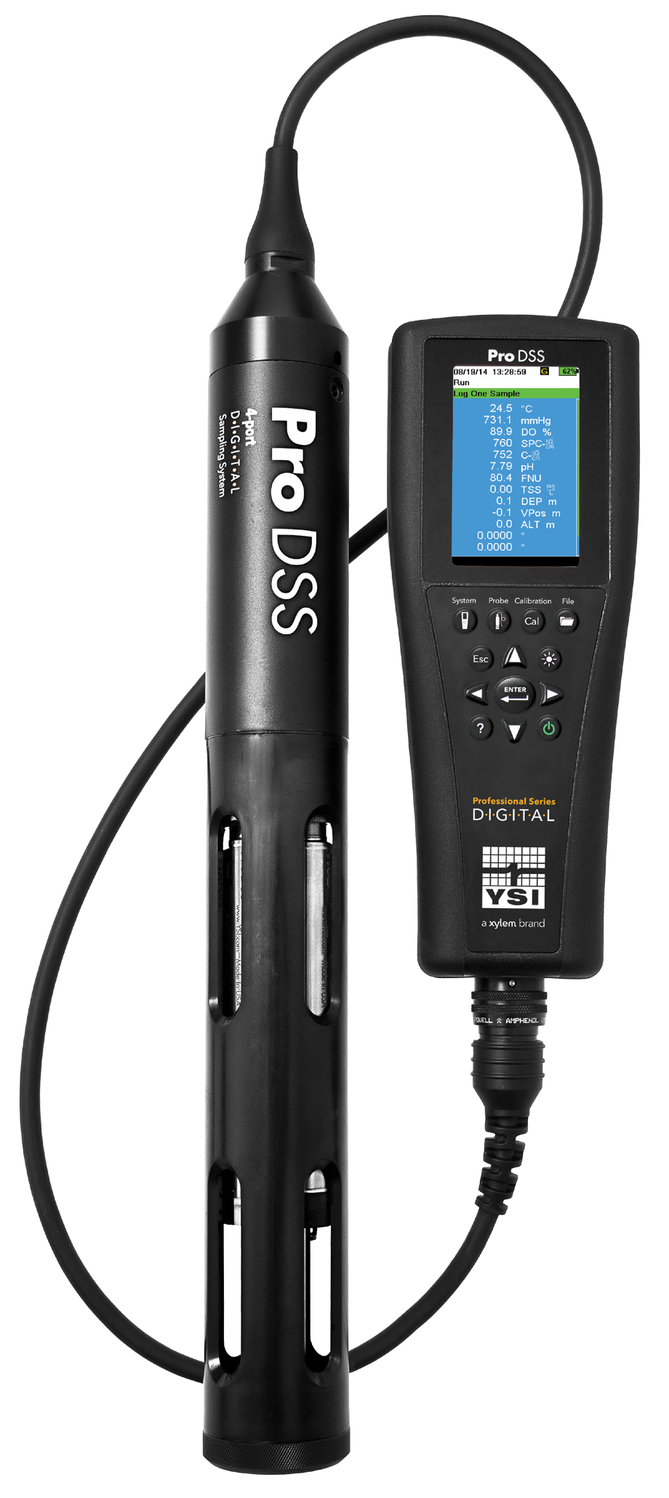
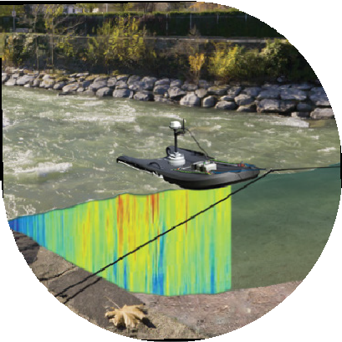
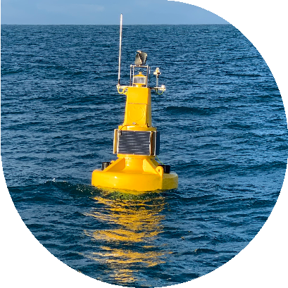
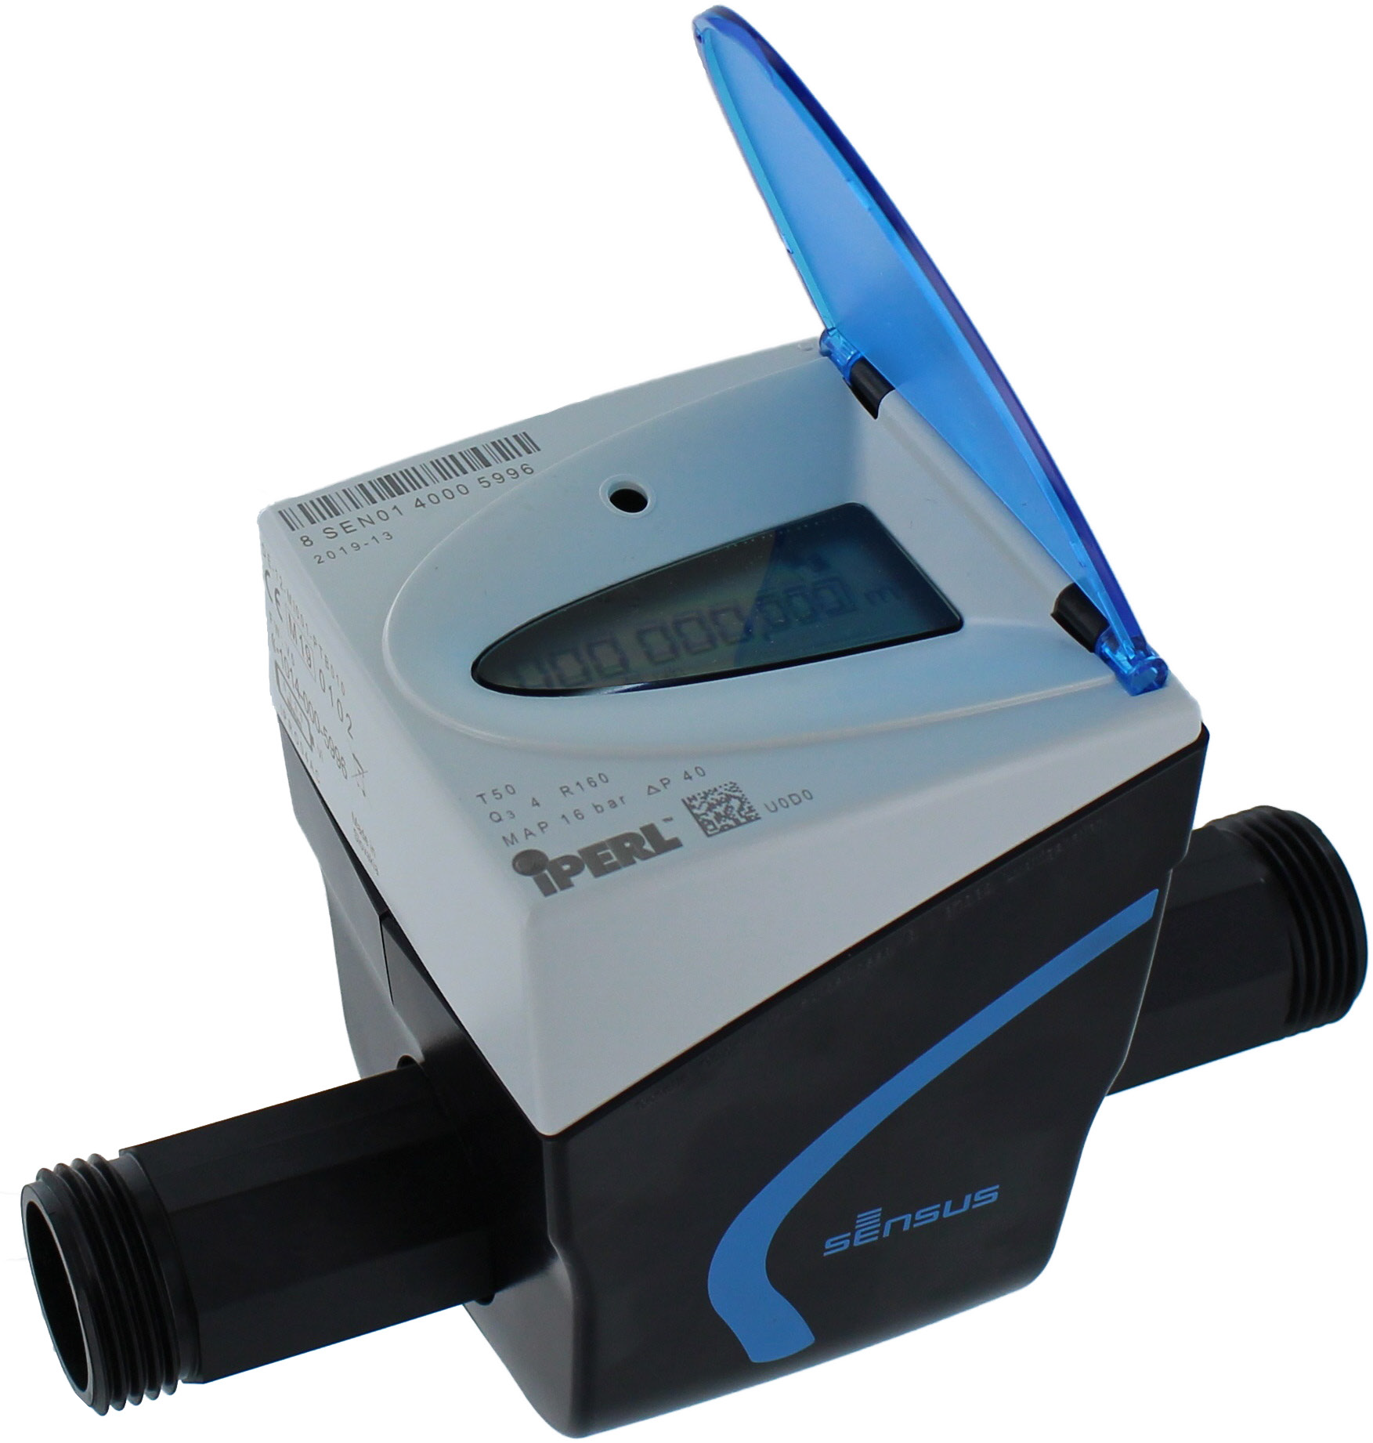

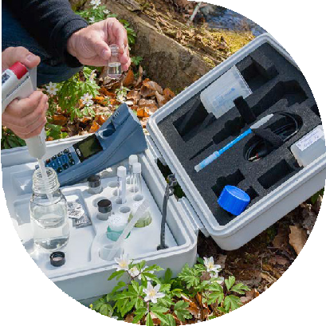
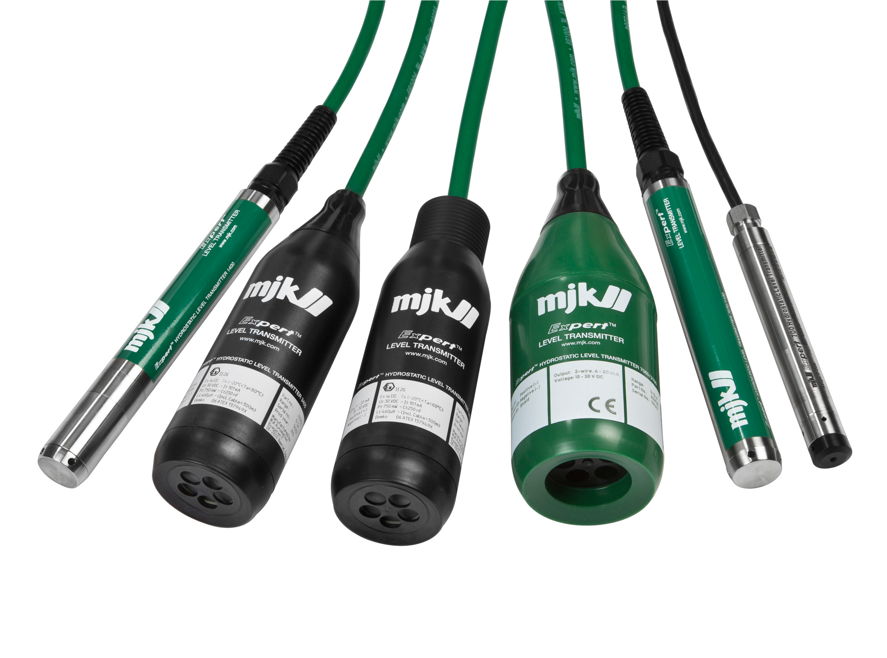
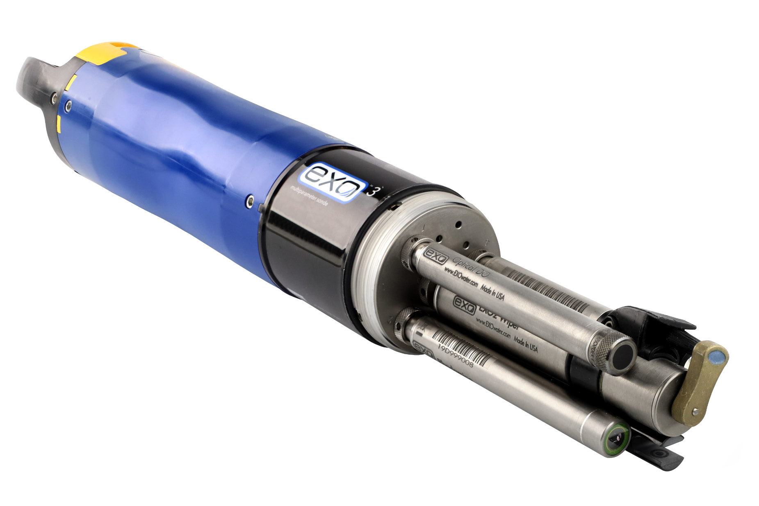
Water transport | Water treatment | Measurement & Control | NRW reduction | Digital water
PMC smart metering project : 325,000 smart meters deployed
Smart metering, analytical instrumentation and data collection platforms
Think Real Time
Trusted
Designed to ensure safer environment by measuring real time critical parameters, improve billing accuracy & meeting tighter regulations.
PARTNER IN MEASURE & CONTROL
Sector
Municipal, Buildings & Industries
Success stories
National Informatics Center, Chilika Lake – Odisha, Indira Gandhi Nahar Department, Pune Municipal Corporation for smart metering
Level Sensors
Handheld Probe
Portable Flow
Multiparameter
Floating Buoy
Smart Metering
Continuous Flow Monitoring
Portable Lab in the Field for JJM (BIS IS 10500:2012)

Slide 8
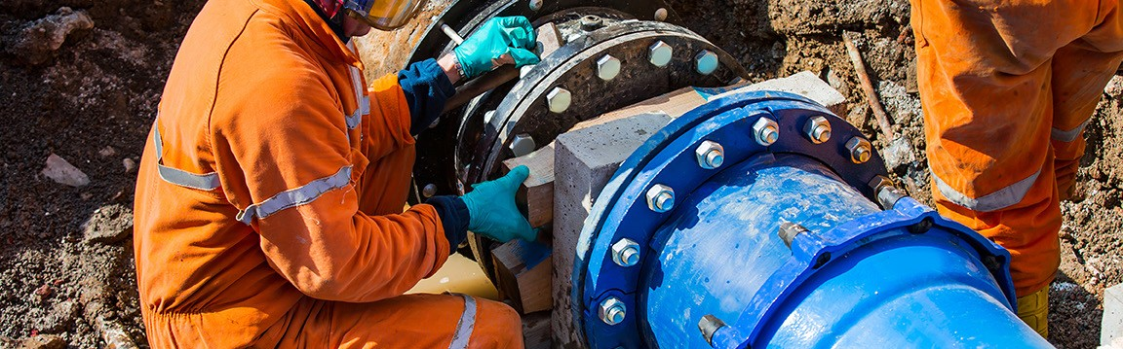
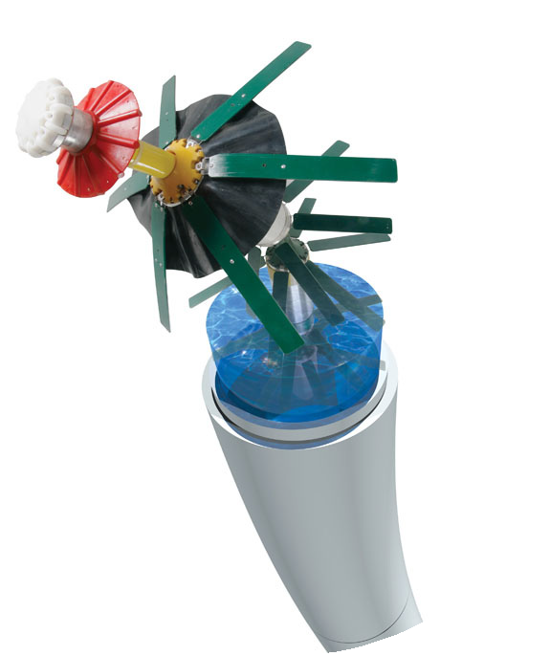
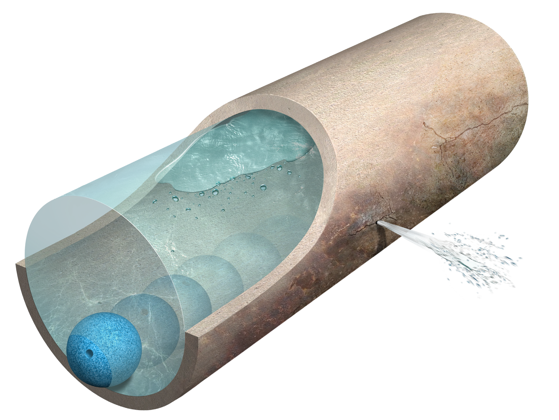
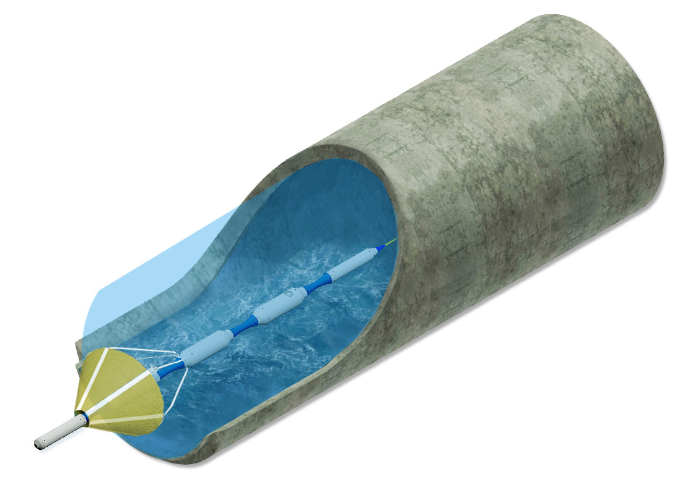
Water transport | Water treatment | Measurement & Control | NRW reduction | Digital water
Leak detection at Reliance Industries
Inline leak detection & pipe assessment to prevent water losses & protect pipelines
Think Water Saving
Trusted
Designed for live inspection in pipeline in operation for accurate locations of leaks and gas pockets
PARTNER IN NRW REDUCTION & PIPELINE ASSESSMENT
Sector
Municipal, Utilities & Industries
Success stories
12000 km inspected and detected 3000 leaks. Reliance, IOCL, BPCL, Essar etc
SmartBall
Sahara
PipeDiver
Free-swimming tool for accurate leak and gas pocket detection
Tethered inspection tool for assessing pipelines with live visual condition and maps pipeline
Free-swimming pipeline condition assessment tool that provides pipe-by-pipe wall condition data

Slide 9










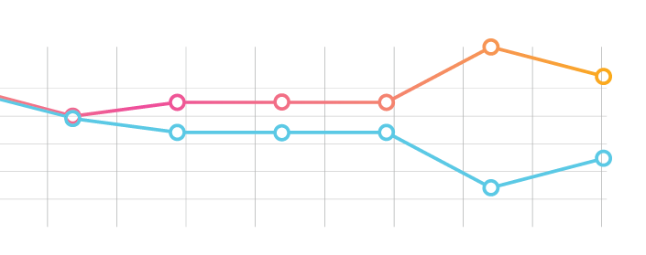



Water transport | Water treatment | Measurement & Control | NRW reduction | Digital water
ENTERPRISE-LEVEL OPTIMIZATION
To deliver outcomes throughout the water cycle.
Digital Helps Customers Achieve Sizable Savings…
$70B
CAPEX
REDUCTION
SYSTEM
OPTIMIZATION
OPEX
REDUCTION
POTENTIAL ANNUAL SAVINGS FROM DIGITAL
DATA SOURCES SPECIFIC TO
YOUR SYSTEM:
REAL-TIME DECISION
SUPPORT SYSTEM
Ingest all data, using our Digital Solutions and expert-led project delivery and management.
GIS
Work & Maintenance
Hydraulic Models
SCADA
Pressure &
Acoustic Sensors
AMI Meter Data
Financial
Public Data
Weather Feed
Additional Meters
& Sensors
NON-REVENUE
WATER
REGULATORY COMPLIANCE
ASSET
RELIABILITY
WASTEWATER
NETWORK
OPTIMIZATION
TREATMENT
SYSTEM
OPTIMIZATION
REVENUE LOCATOR
WATER LOSS MANAGEMENT
ASSET PERFORMANCE OPTIMIZATION

Slide 10
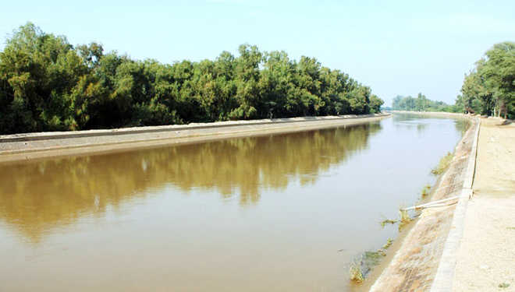
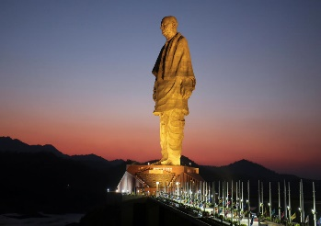
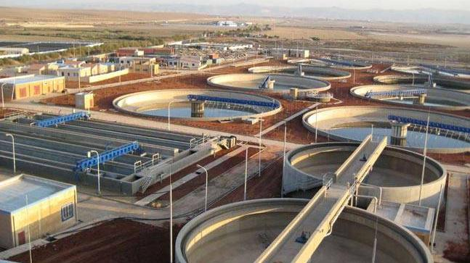
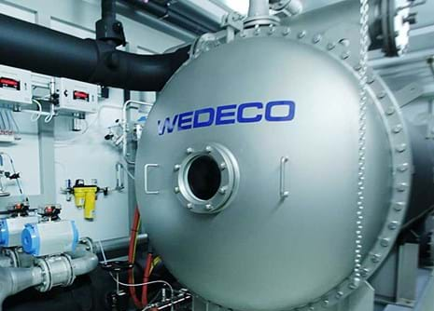
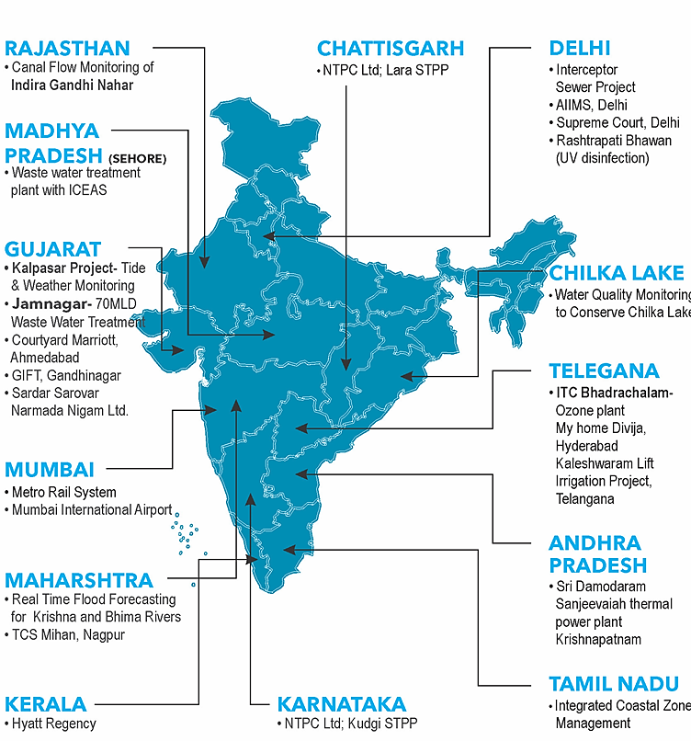
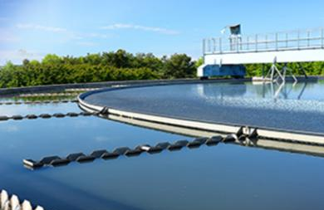
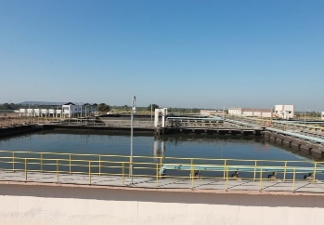
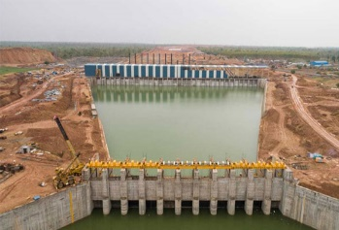
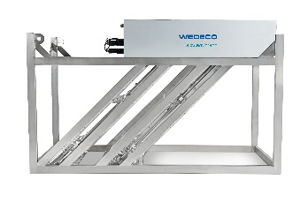
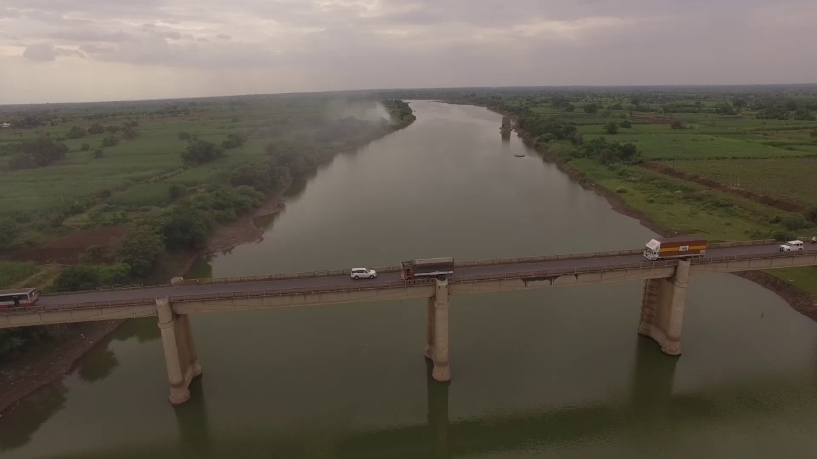
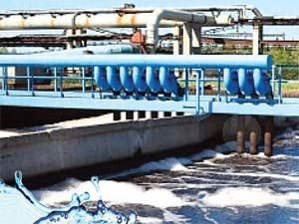
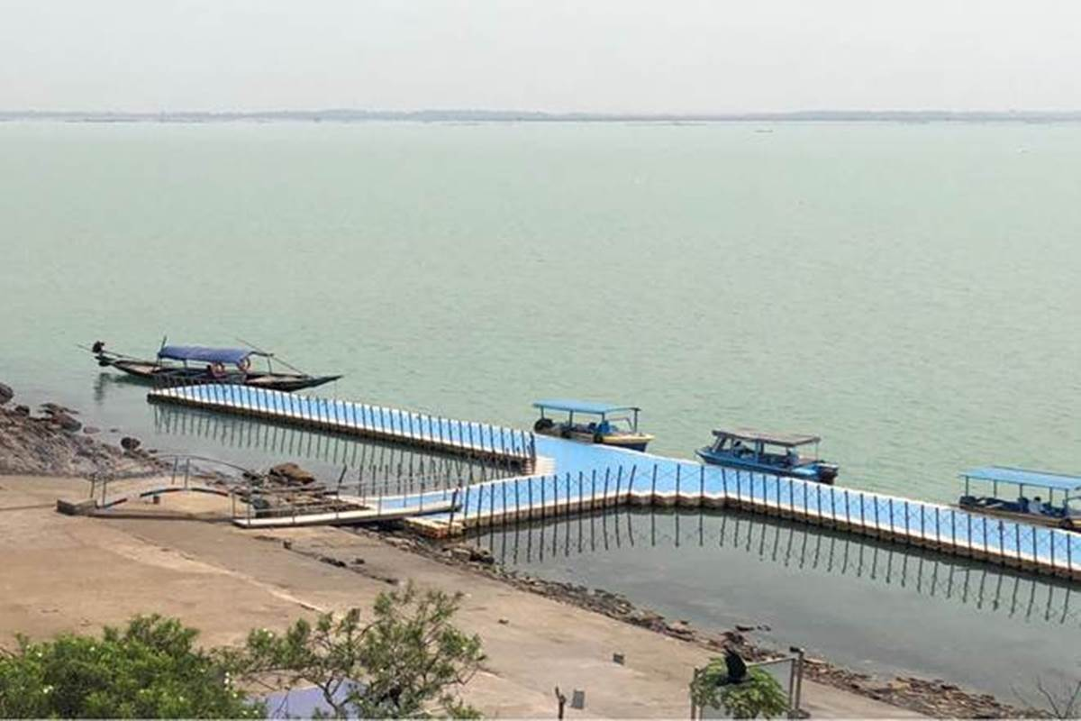
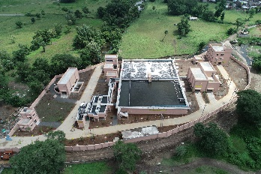
Key Projects & Installations
Canal Flow Monitoring of Indira Gandhi Canal, Rajasthan
Statue Of Unity, Pressure boosting system, Gujarat
Realtime Wastewater Quality Monitoring and Interceptor Sewer Project, Delhi Jal Board, New Delhi
ITC Bhadrachalam- Ozone plant, Telangana
Largest UV at Delhi Okhla
MCGM, Three projects at Mumbai* (> 1000 MLD)
70MLD Wastewater Treatment in Jamnagar, Gujarat
Kaleshwaram Lift Irrigation Scheme, Pumping Solutions, Telangana
Largest UV at Delhi Okhla*
MCGM projects
Wastewater plant with ICEAS in Sehore, Madhya Pradesh
Real Time Flood Forecasting for Krishna and Bhima Rivers, Maharashtra
Mumbai’s Metro Rail System
Wastewater treatment (ICEAS, UV), Maharashtra
Water Quality Monitoring to Conserve Chilka Lake, Odisha
*Project under execution

Slide 12

INTELLIGENT WATER SYSTEMS
Data integration challenges

Slide 13
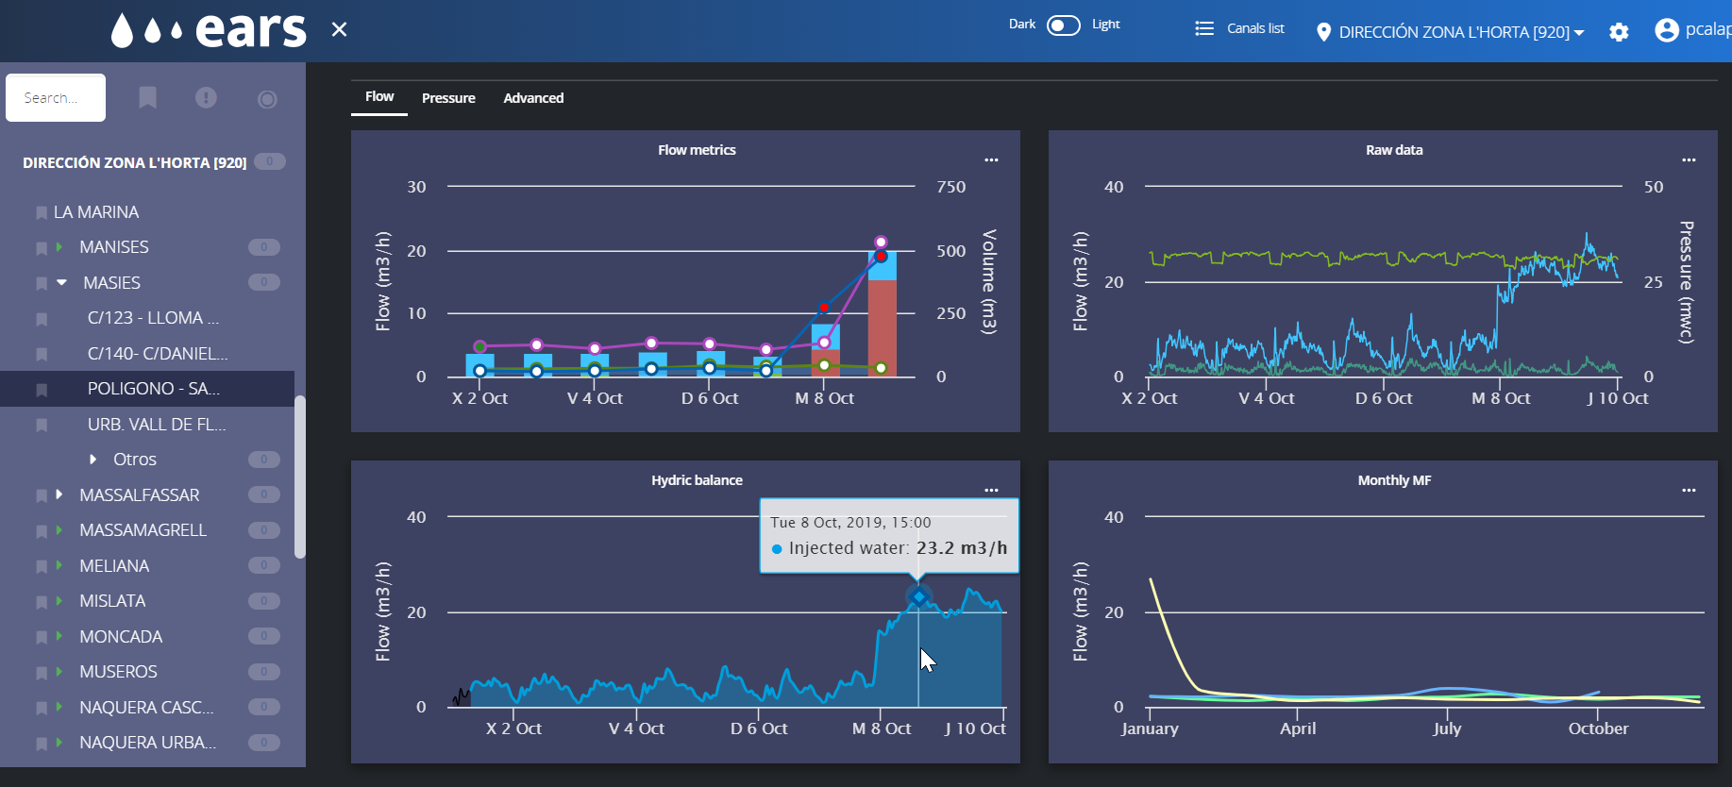




INTELLIGENT WATER SYSTEMS – OUR HISTORY
THE CHALLENGES
20 different SCADA technologies
MAIN CHALLENGES
28+ drinking
water
treatment plants
Information was captive in each technology –WinCC, Wonderware, data loggers,…
We were dependent on expert resources to do anything (integrate new components, extracting information…)
10,000+
electro-mechanical assets
300+ waste water treatment plants
Historical information was hard to access – only for a few months
Crossing information between different technologies took us a lot
10,000+ miles
of pipes
monitored
constantly
2,000+ DMAs monitored hourly
Generating reports, KPIs, and insights was very hard
Notes:
Where does IDRICA and GoAigua come from?
Idrica is a Spanish company focused on water specific software spun out of Global Omnium
Global Omnium is a water and wastewater utility operator that is serving over 300 utilities in Europe, Middle East, Africa and Latin America,
All Global Omnium utilities use Idrica technology
One of the key value propositions from Idrica is its scalable, modular platform, intuitive interface and powerful applications
In addition, another key value of Idrica is the fact that it was born and developed by utilities for utilities – all solutions are tested with Global Omnium
Global Omnium
Innovative Spanish utility operator
3M+ customers served across 300+ utilities in EU, MEA, LATAM
Sandbox for developing and testing
Idrica
Digital platform provider spun out of Global Omnium in 2018
Developed from operational experience running utilities
Serves over 300 utilities worldwide
Operates in Brazil, Canada, Chile, Colombia, Ecuador, Hong Kong, Mexico, Perú, Qatar, Romania, Spain, Saudi Arabia, and USA

Slide 14












DISTRIBUTED DIGITAL SOLUTIONS
Annual Revenues
Employees
Water scarcity and increasing cost of water treatment
2005 - 2017
+3,000
$450M+
Great use cases solving O&M needs through in-house solutions
Years of Experience
Information siloes between areas and technologies (SCADAs, GIS, CMMS, ERP)
+130
Wastewater Treatment Plants
Generational gap – senior operators with know-how, and younger digital-natives
300
Smart Water Simplified
10+ bn data points / year connected
400+ clients worldwide
Notes:
Where does IDRICA and GoAigua come from?
Idrica is a Spanish company focused on water specific software spun out of Global Omnium
Global Omnium is a water and wastewater utility operator that is serving over 300 utilities in Europe, Middle East, Africa and Latin America,
All Global Omnium utilities use Idrica technology
One of the key value propositions from Idrica is its scalable, modular platform, intuitive interface and powerful applications
In addition, another key value of Idrica is the fact that it was born and developed by utilities for utilities – all solutions are tested with Global Omnium
Global Omnium
Innovative Spanish utility operator
3M+ customers served across 300+ utilities in EU, MEA, LATAM
Sandbox for developing and testing
Idrica
Digital platform provider spun out of Global Omnium in 2018
Developed from operational experience running utilities
Serves over 300 utilities worldwide
Operates in Brazil, Canada, Chile, Colombia, Ecuador, Hong Kong, Mexico, Perú, Qatar, Romania, Spain, Saudi Arabia, and USA

Slide 15







Breaking the siloes (new IT architecture – real big data)
2018
From siloed applications to a centric smart water platform
Notes:
Where does IDRICA and GoAigua come from?
Idrica is a Spanish company focused on water specific software spun out of Global Omnium
Global Omnium is a water and wastewater utility operator that is serving over 300 utilities in Europe, Middle East, Africa and Latin America,
All Global Omnium utilities use Idrica technology
One of the key value propositions from Idrica is its scalable, modular platform, intuitive interface and powerful applications
In addition, another key value of Idrica is the fact that it was born and developed by utilities for utilities – all solutions are tested with Global Omnium
Global Omnium
Innovative Spanish utility operator
3M+ customers served across 300+ utilities in EU, MEA, LATAM
Sandbox for developing and testing
Idrica
Digital platform provider spun out of Global Omnium in 2018
Developed from operational experience running utilities
Serves over 300 utilities worldwide
Operates in Brazil, Canada, Chile, Colombia, Ecuador, Hong Kong, Mexico, Perú, Qatar, Romania, Spain, Saudi Arabia, and USA

Slide 16

































Global footprint
Global footprint
CITY OF TORONTO
Technology
Digital transformation consultancy & PoC
GLOBAL OMNIUM
Technology
SW Maintenance and Framework Agreement
CONSORCIO DE AGUAS
BILBAO BIZKAIA
Technology
SW Billing and Customer Care
EMPRESA MANCOMUNADA DEL ALJARAFE, S,A,
Technology
Asset & Mobility Manager (GAM)
EMASESA
Technology
SW XVPGA
AGUAS DE BURGOS
Technology
SW Billing and Customer Care
TAIGUA, AGUA MUNICIPAL DE TERRASA
Technology
SW XVPGA
+400 water systems
+3,000,000 data points
HOUSTON
Solutions
CSO/SSO early warning
CHINO
Solutions
XVPGA FlowSens, Meter Insights y Water Twin,
CITY OF BURLINGTON
Solutions
SARS Analytics
BRABANT WATER
Technology
Digital Twin Consultancy
SW XVPGA
AA EN MAS
Technology
Digital Twin Consultancy
SW XVPGA
SOCWA
Solutions
Biorisk
WATER UTILITY MANAGEMENT (SAVANNAH)
Solutions
Billing and Customer Care
LONG BEACH WATER
Services
Asset Management
YORKSHIRE WATER
Technology
Implementation of XVPGA platform
Netherlands
CA ARIES
Technology
SW XVPGA
APAVITAL IASI Technology
Pipeplanner
ROMANIA
SACMEX
Services and technology
Digital Transformation and loss control
CANADA
ITALY
ELECTRICITY WATER AUTHORITY Technology
SW XVPGA
USA
SPAIN
WATER SUPPLIES DEPARTMENT
Technology
Development of a digital twin
for fresh water network,
MEXICO
TRIPLE A S,A,
Technology
SW XVPGA
BAHRAIN
SAUDI ARABIA
QATAR
HONG KONG
COLOMBIA
PUBLIQCQUA
Technology
SW XVPGA
EPA (EMPRESA PUBLICA DEL AGUA)
Services and technology
Digital Transformation and Technical Assistance
ECUADOR
ANGOLA
Ashghal – PUBLIC WORKS AUTHORITY
Services and Technology
West catchment zone - WW
KAHRAMAA
Services and Technology
Supply of Leak equipment
PERÚ
SEDALIB (TRUJILLO)
Solutions
Billing and Customer Care
CHILE
ARGENTINA
MINISTRY OF ENERGY AND WATER (WORLD BANK)
Services
Technical assistance for the O&M (Malanje, Uige & N´Dalatando)
NEOM
Technology
Implementation of 5G technology for water meters in Neom
AUSTRALIA
SA WATER
Technology
SW XVPGA
ESVAL (VALPARAISO)
Solutions
Work Orders & Water Twin
AGUA Y SANEAMIENTOS ARGENTINOS
Services
Water Loss Control

Slide 17
SUSTAINABLE INTELLIGENT WATER SYSTEM

Slide 18







JOURNEY TOWARDS UTILITIES’s DIGITALIZATION PATH
Sensors
It is necessary to have information on pressures, flow rates, levels, pump status and valve opening..
DIGITAL TWIN
Real-time information of the system and real-time calibrated hydraulic model. Ability to perform what-if scenarios based on real boundary conditions.
Real Time Decision Support System
Support in decision making, considering information from different applications in Real time. Suggestion of
prioritized actions for utterly system optimization
Dataloggers and communication systems
The calculation of the water balance depends on two variables: water injected into the network and water consumed.
SCADA
In the case of existing SCADAs in the modeled distribution network, it is possible to connect both systems to share data to calibrate and optimize the performance of the hydraulic model..
Operational Intelligence
Make data-driven decisions supported by enhanced analytics utilizing Artificial
Intelligence (AI)
Hydraulic Model
It is necessary to have a complete model of the distribution network as a necessary tool for the operation and management of the system.
Full Operational Awareness
Real-time situational awareness and performance monitoring. Multiple anomalies are detected from a system macro-perspective and providing key insight for decision making
3rd Party Systems
Integration of other operational systems:
Financial Information
Asset Information
GIS
Weather Information
LIMS
PHASE 1
PHASE 2
PHASE 3

Slide 19
























Architecture
Real-time monitoring and actions on key indicators
Operational Intelligence
SERVICE OPERATIONS CENTER
BI CONNECTORS
DASHBOARDS & REPORTING
Analytics, Optimization and Real-Time Decision Support
Unified Network Management
Leak DETECTION & LOCALIZATION
Meter Asset Management
Flood (SSO) /
CSO Prediction & Prevention
Unified Plant Management
Meter Data Analytics
Sewer Tracker
Plant Real-time Decision Support
Modular Data Applications
PipePlanner
Real-time What-if Scenarios
Clog Monitoring
Domain Master Data
IoT CORE
Device Management
GIS Framework
Data Science Framework
Smart Water Engine
Vendor agnostic, integrates with any technology
AMI/AMR
SENSORS
SCADA, PLCs & IoT Sensors
Distributed DBs
GIS, CMMS
Over 120 protocols/systems supported

Slide 20










LAYER 3
Operational Intelligence
Service Operation Centre (SOC) is an Operational Intelligence solution where is possible to integrate any kind of insight (alarms, data, third party information, etc.) from operational applications. SOC allows also to customize analysis through advanced dashboards. In the short term, it will provide also suggestion for a better operation (e.g., prioritisation of alarms).
IoT data integration
BIM integration
Business Intelligence
The operational intelligence layer brings additional Business intelligence capacities to the final users.
It allows customized analysis of the data available in the platform, benefiting from the data architecture of XVPGA.
Cross-boundary insights
Operation recommendation

Slide 21

What is a Digital Twin?

Slide 22
WHY A DIGITAL TWIN?

Slide 23
WHY A DIGITAL TWIN?
Resilience
Adapt quickly to any circumstance in short or long term
Efficiency
Optimisation of systems
Customer centric management
Engage customers and provide information
Generational Change
Digitization and retaining knowledge

Slide 24
HOW A DIGITAL TWIN?
SMART WATER ENGINE
TOOLS TO SOLVE THE SPAGUETTI MODEL
SENSORS
EYES IN THE FIELD
HYDRAULIC MODEL
RUNNING IN REAL TIME AND BEING USED BY OPERATORS NOT BY ENGINEERS

Slide 25


Digital Twin
Data sources
AMI data
SCADA
Customer services
Network operation
Monitoring
Remote operation
SENSORS
Real-time
Historical data series
CMMS & ERP
Repairs & maintenance
Real time connection with field forces
GIS & CRM
Network infrastructure
Customer’s information
BIG DATA
PLATFORM
HYDRAULIC MODEL
Data centric & based on services
Leverage real time data & historians to create intelligence
Application of big data & AI to generate use cases
Advanced analytics
Real-time calibration
DIGITAL TWIN

Slide 26

JOURNEY TOWARDS DIGITAL TWINS
1
2
3
4
5
6
7
8
9
Data integration & analysis
(Data platform)
Integrated control, monitoring & visualisation
Sensors
(Pressure, flow, AMI, etc.)
Hydraulic Model
Integration with other operational systems
Real-Time SCADA
connection
with Hydraulic Model
Real Time Digital Twin
GIS
Smart Operation
Real Time Decision Support System
Operational Intelligence
CRM data

Slide 27





JOURNEY TOWARDS DIGITAL TWINs – DATA INTEGRATION
What is digital sustainability?
3
4
5
6
7
SCADA
GIS
AMI
LIMS
CIS
PLs
Mobility
CMMS
OPC
Data integration & analysis
(Data platform)
Integrated control, monitoring & visualisation
Sensors
(Pressure, flow, AMI, etc.)
Hydraulic Model
Integration with other operational systems
Private Cloud
How do I make Smart Decisions?

Slide 28


JOURNEY TOWARDS DIGITAL TWINs – REAL TIME DATA CONNECTION
Connect everything under a Real Time Digital Twin
8
NEXT ??
REAL TIME WHAT IF SCENARIO
9
APPs
Real-Time SCADA
connection
with Hydraulic Model
Real Time Digital Twin
Smart Operation
Real Time Decision Support System

Slide 29





JOURNEY TOWARDS DIGITAL TWINs – SMART OPERATION
WHAT’S NEXT? : Smart Operation– Operational Intelligence
9
Advance incident management (Operational Awareness)
Full Asset management (BIM)
Decision support system (Macro-perspective)
Service Operation Center
OPERATIONAL INTELLIGENCE
Smart Operation
Real Time Decision Support System
Operational Intelligence

Slide 30

CASE STUDY – Digital Twin in Global Omnium (Valencia)
Full functional Digital Twin since 2009

Slide 31












Global Omnium: a worldwide leader water utility
A Story of a 15-year Digital Transformation
…to a holistic Transformation started in 2005…
…to becoming one of the leading smart water companies, providing software & analytics to hundreds
of utilities globally
From a leading European water utility operator…
Years of Experience
Annual Revenues
Employees
Water scarcity and increasing cost of water treatment
+130
+3,000
$450M+
Information siloes between areas and technologies (SCADAs, GIS, CMMS, ERP)
Cities
Managed
Water Treatment Plants
Wastewater Treatment Plants
Generational gap – senior operators with know-how, and younger digital-natives
400
30
300
Smart Water Simplified
10+ bn data points / year connected
400+ clients worldwide

Slide 32


















GLOBAL OMNIUM’S DIGITAL TWIN
Valencia & metropolitan area
48 municipalities
1.6 million inhabitants
Operators training
REAL TIME WHAT IF SCENARIOS
+250 km. mains (24”-64”)
+1,400 km. network (2”-48”)
Hidden failure detection
+1,700 data/sec (hydraulic, water quality, physical security, energy, assets status, alarms,…)
What-if analysis
Future simulations
+250 km. mains (24”-64”)
+850 km. network (4”-48”)
Maintenance scheduling
204 flowmeters
426 pressure transducers
28 water tanks level
254 control valves
47 pump stations
Energy saving strategy
+400k smart meters
Real-time connected digital twin
Real-time quality model
Demand forecasting
3rd party data aggregation
Indicators
Leak detection for virtual DMAs
96%
98%
Flow accuracy
Pressure accuracy
Breakdown & safety alarm

Slide 33






OUTCOMES OF DIGITAL TWIN OPERATION IN GLOBAL OMNIUM
+9Bn
data processed
per year
+800
SCADAS
+400
hydraulic systems remotely monitored or operated
4 Hm3
water saved
+45%
improvement in administrative tasks related to field work
+60%
complaint reduction related to invoicing
0.3 Hm3
water saved in
household leaks
+6M
invoices per year
~1M
smart meters
+3,100
DMAs with
hourly balance
+18%
NRW reduction
+19%
reduction in maintenance cost
x10
customers registered
in GO virtual office
7,000 Ton
CO₂ saved/year
~ 100k
work orders processed automatically
+15%
energy efficiency
597
leaks detected
per month (avg)
1,250
household leaks
detected
0
people lost their job
Address from multiple angles: IT, hydraulic & people
Can help us to make the difficult easy
Is the way to achieve excellence in operation

Slide 34
Xylem Vue powered by GoAigua Platform overview
THANK YOU
For any demos and technical queries :
Ankur Chaurasia – Sr Solution Architect
Xylem Water India Solution Pvt Limited
ankur.Chaurasia@xylem.com
+91-8860092158

