Slide 1

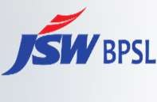

Slide 2

WE ARE JSW STEEL
JSWSteel is oneof India’s leading integrated andgeographically diverse steel manufacturers. Ourgoal is to partner in India’s growthstory by supplying steel forvital infrastructure projects, providing value added steel solutions through innovationwhile investing in sustainability and improving the well-being ofthe broader community.
Wehave adoptedadvanced technologies and processes to ensure that steel continues to be the preferred material as we transition towardsa low-carbon future. Inpursuing ourstrategic objectives, we are committedto responsibly reducing our environmental footprint andpositivelyinfluencing the lives of ouremployees and partners.
28.2 MTPA
Domesticcrude
steel capacity
50 MTPA
Expected domestic capacity by FY2030-31
ATRUEVISIONARY. ALEGENDARYINDUSTRIALIST.A GREAT PHILANTHROPIST.
ALEGACYTHATWILLALWAYSBECHERISHED.
SHRI. O. P. JINDAL
~13.5 MTPA Domestic downstream steel capacity *Includes JSW Steel Coated Products Ltd., Vijayanagar CRM Complex and BPSL | 1.5 MNTPA (Crude Steel Capacity) International presence JSWSteel USA | 364 Brandedstores added in FY 2023-24
100+ Countries (export footprint) | 24 Captiveiron ore mines | 03 Captive coking coal mines
 | 25,550 Direct employees JSWSteel consolidated
07.08.1930 - 31.03.2005
Founder and Visionary, O. P. Jindal Group

Slide 3

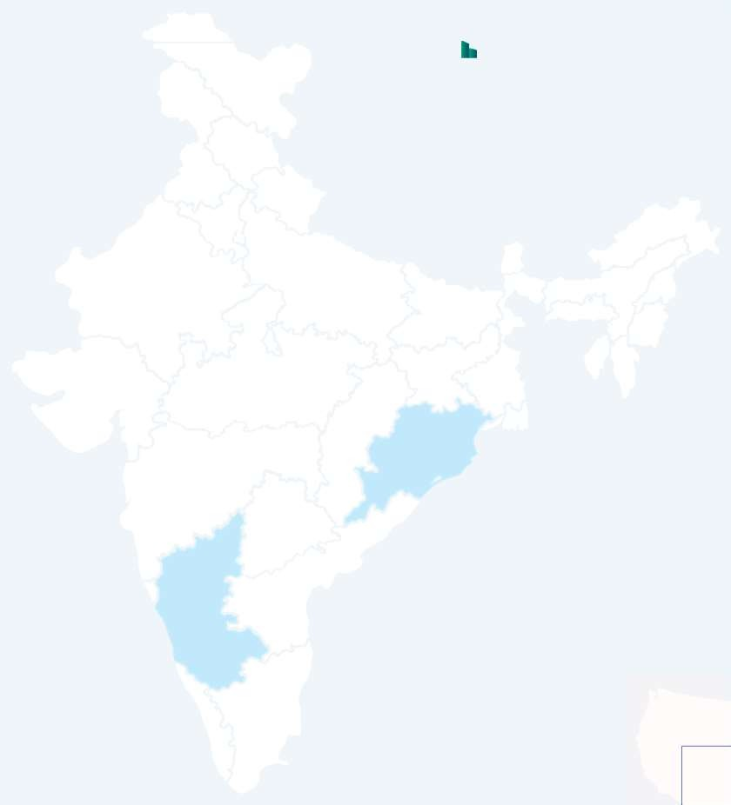








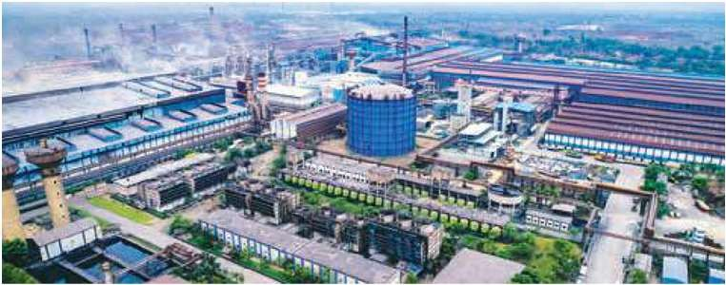





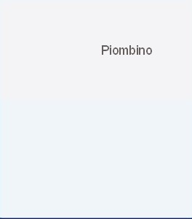








Organisational Overview
OPERATIONS AND PRESENCE
Manufacturing facilities
Downstream facilities ^{Mines}
Manufacturing Facilities
Rajpura
International manufacturing units
Operational iron ore mines
Bawal
Vijayanagar Works (ISP)
Bhushan Powerand Steel Ltd. Sambalpur
Raigarh Works
Dhar
Kalmeshwar
P
Hot Rolled (HR), Cold Rolled (CR), Galvanised (GI) and Galvalume (GL), colour-coated products, wire rods, TMT
P
HR, CR, Galvanised (GI) and Galvalume (GL), colour- coated products, TMT, slabs, billets, cable tape, black pipe, precision tubes
P
Rebars, alloy special steel products, slabs, billets
Anjar
C
0.95 MTPA crude steel
C
12.5 MTPA crude steel
5 MTPAunder commissioning, further addition
of 1.5 MTPAby FY2024-25
C
3.5 MTPA crude steel
1.5 MTPAunder commissioning in phases
Raipur
INDIA
Raigarh
Khopoli
Dolvi Works (ISP)
Vasind & Tarapur
P
HR,TMT
Salav
Sambalpur
10 MTPA crude steel
further addition of
5 MTPAby FY 2027-28
Dolvi
C
Vijayanagar
INTERNATIONAL
Salem
Salem Works (ISP)
Salav Works
Mivaan Steels Limited, Raipur
ITALY
Piombino
USA
P
Wirerod, alloy long products, billets/blooms
P
Direct Reduced Iron (DRI) / Hot Briquetted Iron (HRI)
P
Billets, Ferro alloys, Structures
C
1 MTPA crude steel
C
0.9 MTPA DRI/HBI
C
0.25 MTPA crude steel
Ohio
Key Products Capacity
Baytown
EXPANDING
CAPACITIES AND CAPABILITIES
50 MTPA
Expecteddomestic capacityby FY2030-31

Slide 4

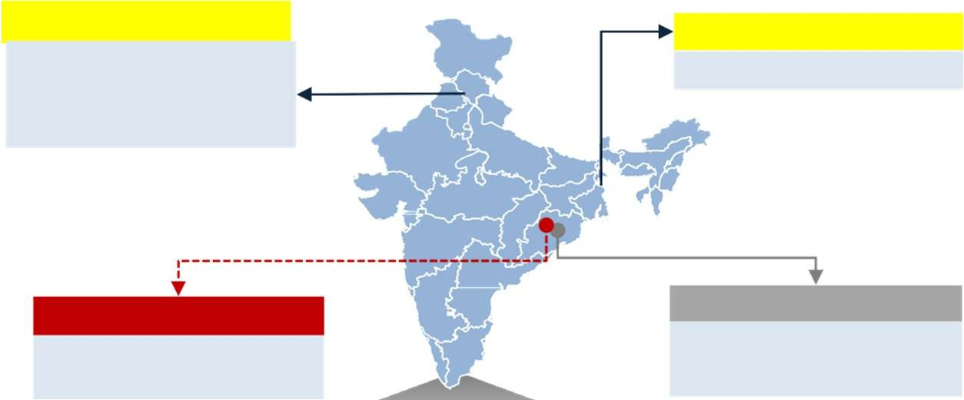







BPSL - Facilities and Capacities Overview
Chandigarh
Kolkata
Value added: CRCA, GI/GL
Cold Rolled Steel Strips and Precision Tubes
Expansion Plan
Crude Steel Capacity
4.50 mtpa
5.00
Sambalpur
Integrated Steel Plant with Captive Power Plant
Netrabandha
Iron Ore Mine: 82mt Reserves
4.50
2.75
Downstream Capacity
1.7 mtpa
Raw Material Processing
Coke Oven Pellet Plant Sinter Plant
Captive Power Plant
Iron and Steel
Value Addition
CRCA / CRFH GI / GL
PPGI / PPGL
Alloy Steel Bars Pipes & Tubes
DRI
Blast Furnaces
Steel Melting Shop
1.80
2.35
FY22
Current
FY25
3.50

Slide 5










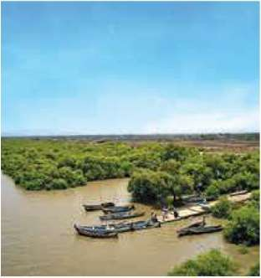
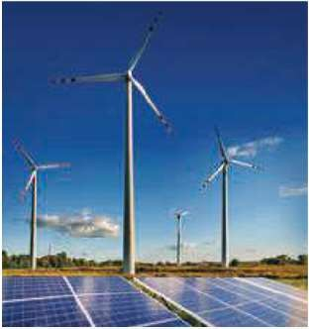
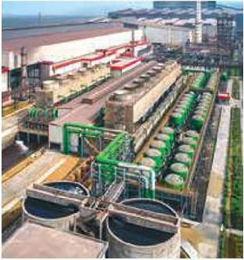
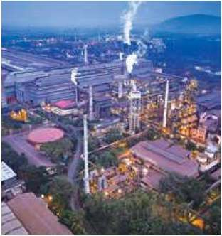
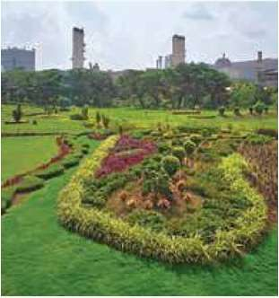



AtJSW,our visionisto actively contributeto society's developmentin a socially, ethically, and environmentally responsiblemanner. Ourgoal is to ensurethat ouractions support meetingthe needs of all, without compromisingthe ability of future generations to meet their ownneeds
Diversity and Safety
Aim to be recognized as one of the world's safest organization by 2030
Achieving 33% women representation at the general engineering and management trainee levels by 2030
Mainstreaming sustainability across the businesses
CAPITALS DEPLOYED _{F} Financial Capital I Intellectual Capital M Manufactured Capital CAPITALS ENHANCED _{S} Social and Relationship Capital N Natural Capital H Human Capital
28% CO₂ emissions from base year
Our commitments
Climate Change
Energy Transition
Water Security
Air Emissions
Circularity and Biodiversity
Targeting Net Neutral by 2050
42%
of CO₂ emission intensity to
1.95 tCO₂/tcs by 2030, aligned
with India’s NDCs
Transition from thermal to renewable energy (RE)- installation of 10 GW REcapacities by 2030
19%
in specific energy consumption to 5.65 Gcal/tcs by 2030
Maintaining zero liquid discharge
39%
in specific water consumption to 2.21 m³/tcs by 2030
Water neutrality at coated steel plants by 2030
PM, SOxand NOx emission targets of 0.26, 0.82 and
0.91 kg/tcs respectively,
by 2030
100% recycling of all waste generated from operations
‘No net loss’ of Biodiversity by 2030

Slide 6













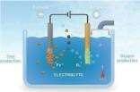
Targeting Net Zero by 2050
Short-Term
Medium and Long-Term
Ensuring Energy Efficiency
Renewable Power (Energy Transition)
Commercial Deployment of Green Hydrogen for Steelmaking
Nature Based Solutions
Use of Syngas & TGR¹ in BF (Carbon Circularity)
Actively Improving Material Quality
Enhancing Process Efficiency
Scrap-based EAF
Increasing Demand-side Material Efficiency
Carbon Offsetting
Utilizing Alternative Fuel Sources
Increase in Scrap (Material Circularity)
Large Scale Implementation of CCUS²
Alternate Steel-making Technologies, e.g. Electrolysis

Slide 7

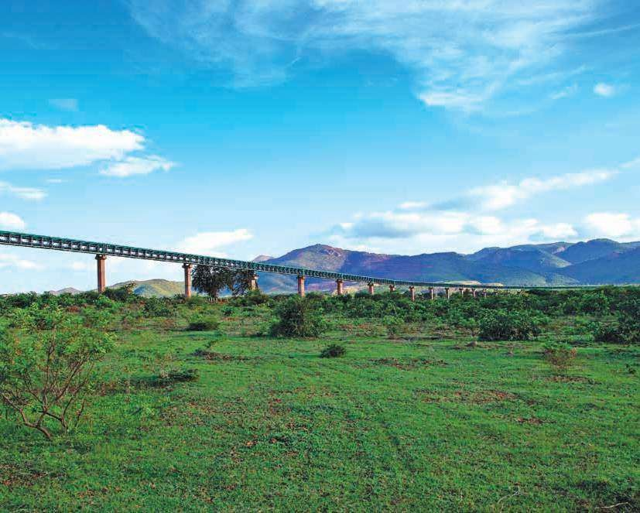



Our focus areas and performance
Focus Areas
KPIs
Units
FY 2023-24
FY 2022-23
FY 2021-22
FY 2020-21
CO₂ emissions (Scope 1 and 2)
‘000 tCO
2
53,167
49,359
44,211
37,523
Climate Change
CO₂ emissionintensity(Scope 1 and 2) tCO₂/tcs
2.44
2.36
2.50
2.49
Specific energy consumption _{Energy} Energy consumptionwithin |  |  | Gcal/tcs million GJ | 5.68 517.69 | 5.66 494.38 | 6.04 446.78 | 6.38 402.53
the organisation
Specificiron ore consumption |  |  | t/tcs | 1.57 | 1.58 | 1.82 | 1.68
^{Resources} Specific coal consumption |  |  | t/tcs | 0.74 | 0.74 | 0.67 | 0.69
Specific freshwater consumption |  |  | m³/tcs | 2.39 | 2.45 | 2.45 | 2.41
Water Resources | (Forsteel production)
 | Non-hazardouswaste generated |  | ‘000 tonne | 15,070 | 14,278 | 13,157 | 11,968
 | Hazardous waste generated |  | ‘000 tonne | 141.00 | 136.25 | 122.9 | 84.62
 | Waste recycled | % |  | 99.11 | 99.77 | 100 | 92.67
Wastewater | Wastewater recycled |  | ‘000 m³ | 22,557 | 20,782 | 16,539 | 16,050
 | Particulate matter |  | kg/tcs | 0.38 | 0.42 | 0.488 | 0.48
 | SOx |  | kg/tcs | 1.66 | 1.69 | 1.895 | 2.05
 | NOx |  | kg/tcs | 1.19 | 1.19 | 1.26 | 1.52
Biodiversity | Saplings planted |  | Nos.(lakh) | 3.5 | 3.5 | 3.5 | 1.5
Waste
INNOVATING FOR GREENER TOMORROW
Airemissions

Slide 8
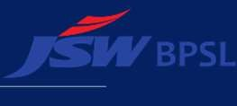






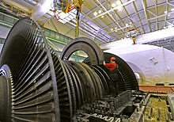
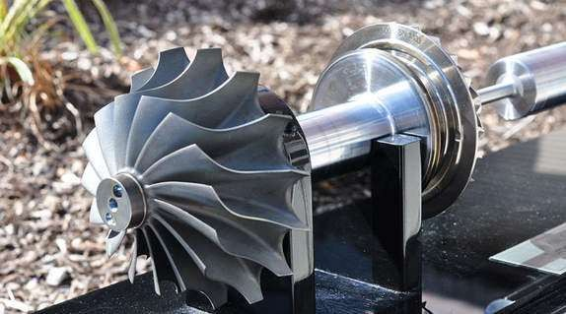
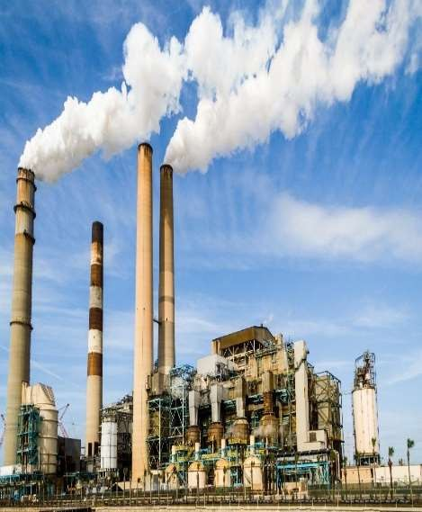
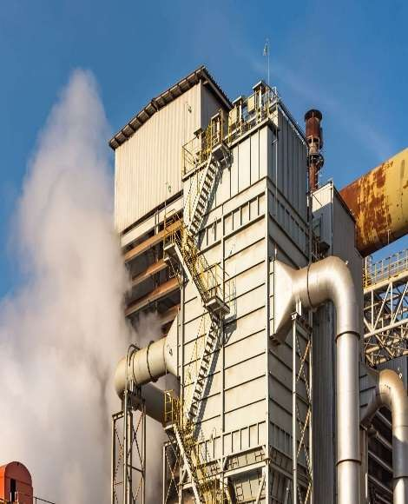
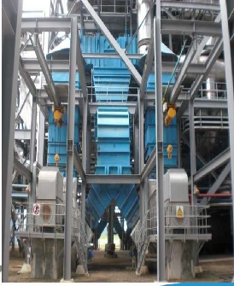
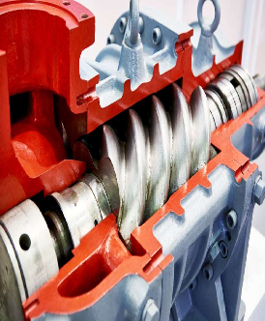



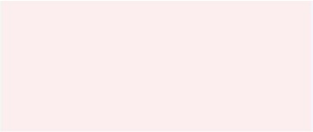
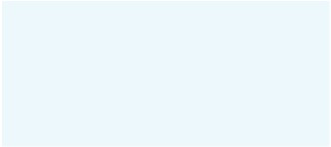
FY 2023-24 ENCON HIGHLIGHTS
TG-1(130 MW COH
Micro turbine 3.5 MW
LDO Consumption Optimization
Tunning fork level switch
PA fan air friction reduction
BFP
Destaging
3.85 to 3.76 T/ MWh
SSC reduction
13.10% to 12..60 %
APC reduction
2 KL per lit-up
LDO usages Saved
3 MW/day
Power saving
1.4 MW/day
Power saving
3.7 MW/day
Power saving
105 MW to 115 MW
MW Optimization
Energy saved
throttlingloss
113. lacs
Cost Saving
44.6 lacs
Cost saving
31.5 lacs
Cost saving
82.2 lacs
Cost saving
Reduction in 4,553 tCO2
Reduction in 1,366 tCO2
Reduction in 76 tCO2 emissions
Reduction in 683 tCO2 emissions
Reduction in 327 tCO2 emissions
Reduction in 847 tCO2 emissions
emissions
emissions
Ratings
OUR VALUE IMPACT
75
ESG Score
A
Water Security
Onlysteelmaker globallywith Aratingin Water Security
A-
Climate Change
7

Slide 9
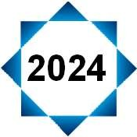
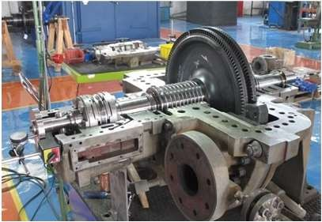
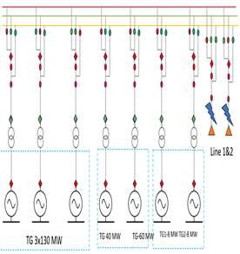
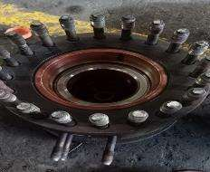
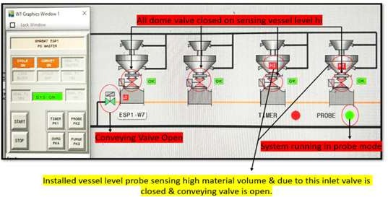


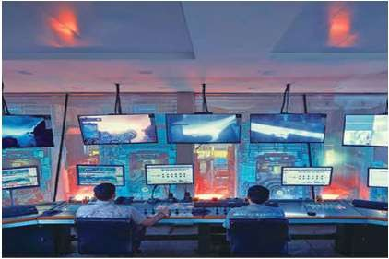
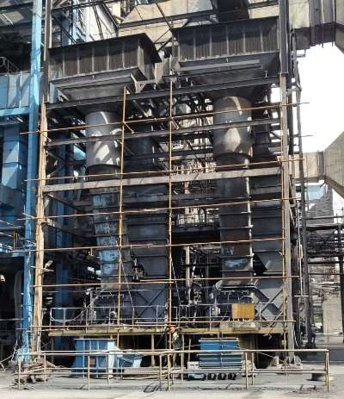

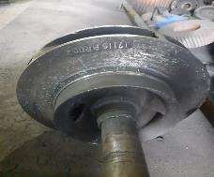
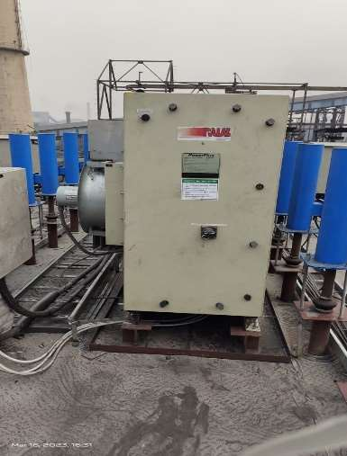
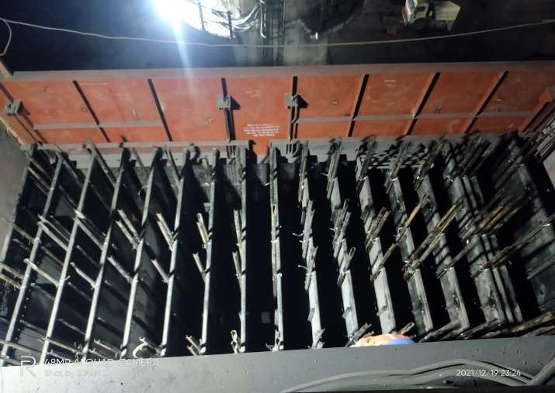
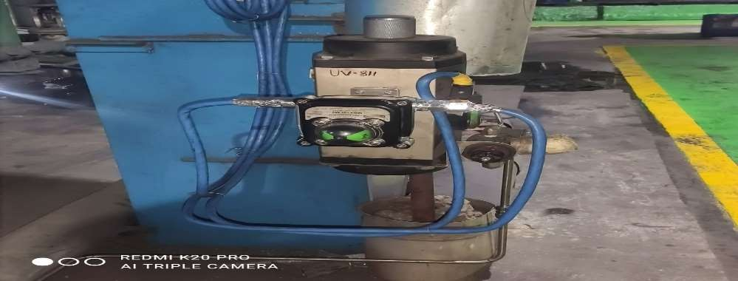
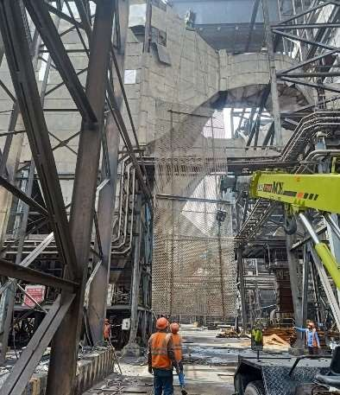
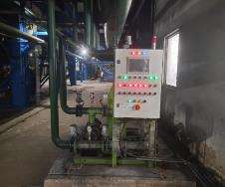
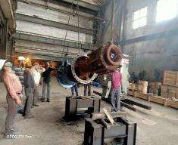
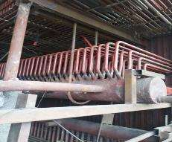
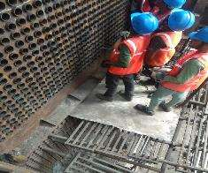
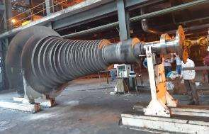
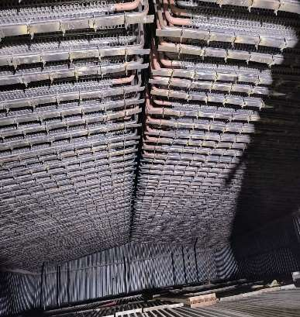




Energy Conservation Journey
2024
2019
Installation of Micro turbine at
PRDS station
Tunning fork type level switch in ESP hoppers reduces APC 3MW/day in CFBC & WHRB
Microturbine
CILMS implementation
BFP ARC valve repairing
Implementation of PMS for plant performance assessment diagnostic optimization
2020
PA canopy
modification
DMCC Impeller trimming
ESP new TR set
Additional CE & DE fields in ESP
High energy drain valve
2021
2022
2023
ESP modification
Condenseronlinetube cleaning system
CEP Stagetrimming
Boiler overhauling
APH tubereplacement
Turbine Overhauling
Boilermajor
overhauling

Slide 10
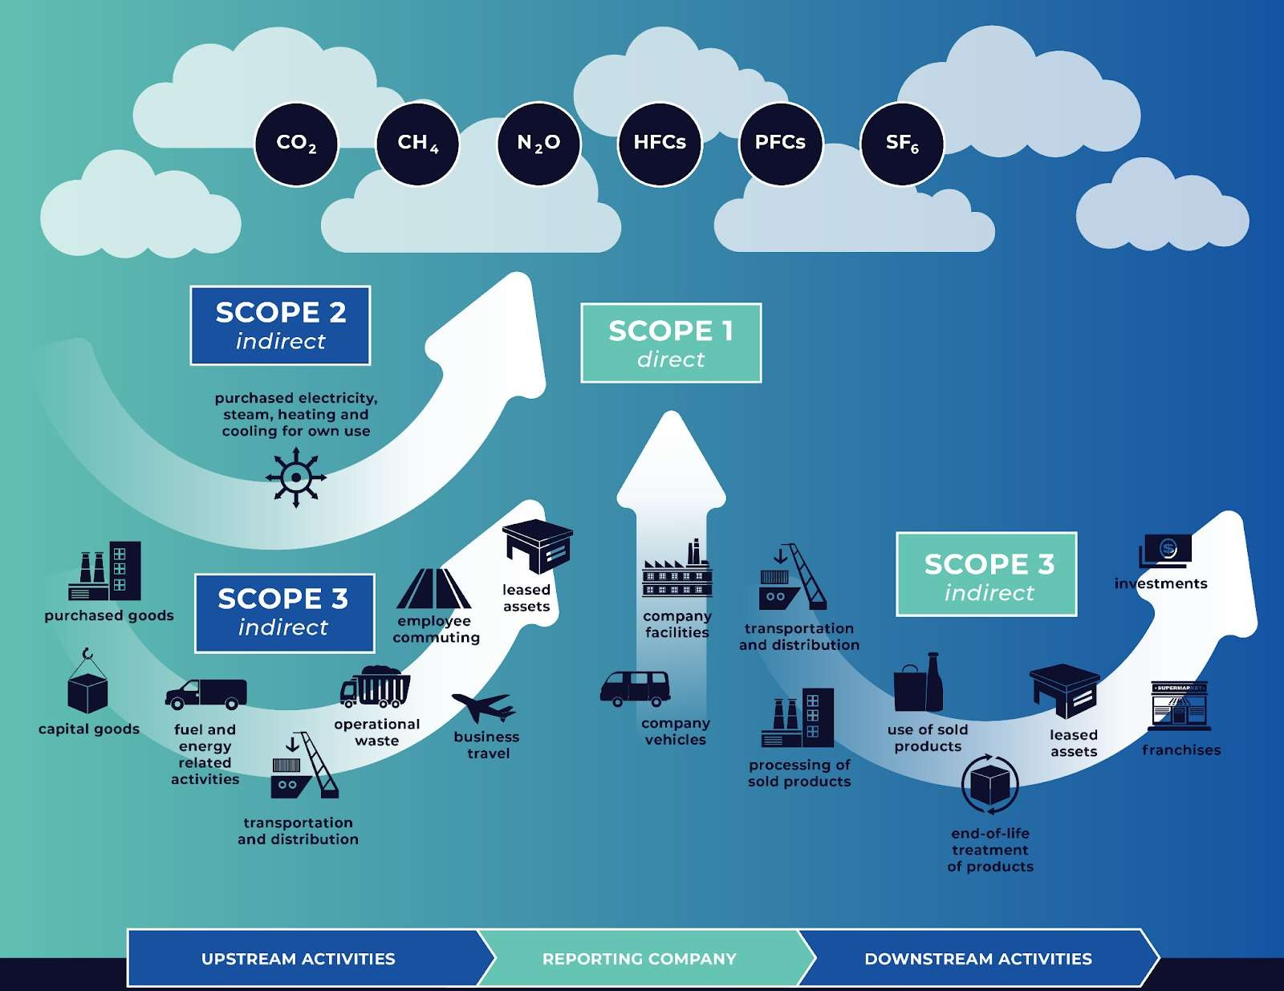
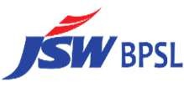
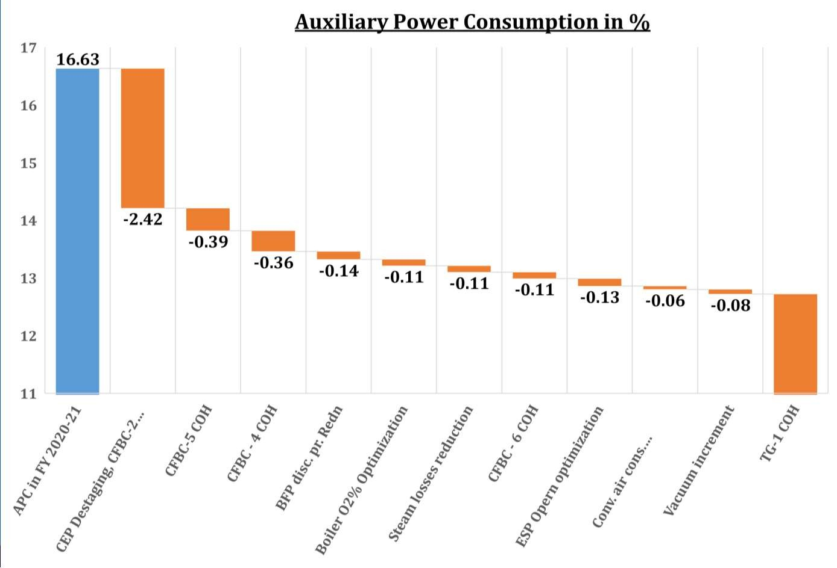
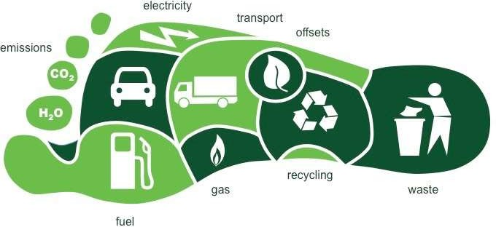
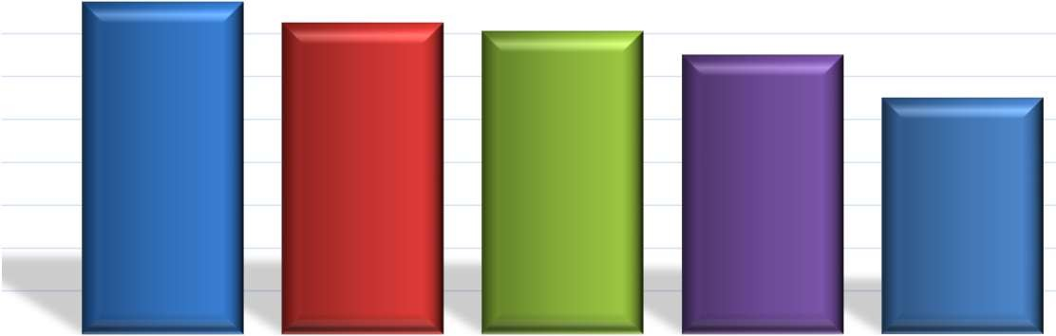
12.72
18.00%
16.00%
14.00%
15.47%
14.50%
14.10%
13%
11%
12.00%
10.00%
8.00%
6.00%
4.00%
2.00%
0.00%
Aux.Power
FY-21 FY-22 FY-23 FY-24 FY-25

Slide 11

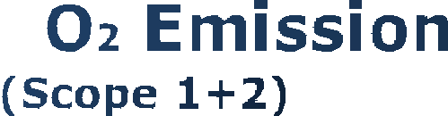
































































ESG Dashboard
Environment
2005 to 2030: 42% ↓
2024 to 2030: 20% ↓
2005 to 2030: 19% ↓
2024 to 2030: 0.6%↓
2005 to 2030: 38 pp ↑
tCO2/tcs
GCal/tcs
%
3.39
6.94
6.59
6.56
6.38
100%
99.77%
99.11%
100%
6.24
6.04
5.66
5.68
93%
2.59
2.75
5.65
2.52
2.49
2.50
2.36
2.44
1.95
62%
FY 05
FY 18
FY 19
FY 20
FY 21
FY 22
FY 23
FY 24
FY 30
FY 05
FY 18
FY 19
FY 20
FY 21
FY 22
FY 23
FY 24
FY 30
FY 05
FY 21
FY 22
FY 23
FY 24
FY 30
2005 to 2030: 39% ↓
2024 to 2030: 8% ↓
2005 to 2030: 72% ↓
2024 to 2030: 31% ↓
2024 to 2030
Specific NOx Emission Intensity: 24% ↓ Specific SOx Emission Intensity: 51% ↓
kg/tcs
m³/tcs
4.13
kg/tcs
Specific NOx Emission Intensity
Specific SOx Emission Intensity
2.05
1.88 1.89
1.74
3.60
3.79
0.93
0.98
0.94
0.98
2.60
2.41
2.45
2.45
2.39
1.60
1.52
1.69
1.69
2.21
1.24
1.29
1.36
1.26
1.19 1.19
0.48
0.49
0.42
0.38
0.82
0.91
0.26
FY 05
FY 18
FY 19
FY 20
FY 21
FY 22
FY 23
FY 24
FY 30
FY 05
FY 18
FY 19
FY 20
FY 21
FY 22
FY 23
FY 24
FY 30
FY 18 FY 19 FY 20 FY 21 FY 22 FY 23 FY 24 FY 30

Slide 12






























































Social
number
number
number
12,954
12,481
12,398
12,856
13,301
7,591
11,619
11,266
6,682
6,557
6,868
6,893
6,932
6,746
6,619
5,588
6,110
5,062
4,398
5,363
5,466
FY 18
FY 19
FY 20
FY 21
FY 22
FY 23
FY 24
FY 18
FY 19
FY 20
FY 21
FY 22
FY 23
FY 24
FY 18
FY 19
FY 20
FY 21
FY 22
FY 23
FY 24
number
number
per million manhours
858
40
0.43
743
32
32
0.36
659
639
666
28
0.32
0.32
480
23
24
0.26
403
19
0.20
0.095
FY 18
FY 19
FY 20
FY 21
FY 22
FY 23
FY 24
FY 18
FY 19
FY 20
FY 21
FY 22
FY 23
FY 24
FY 18
FY 19
FY 20
FY 21
FY 22
FY 23
FY 24

Slide 13

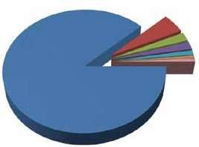
Water intensive industries in focus
Engineering, 5.05% Pulp & Paper, 2.26% Textiles, 2.07%
Steel, 1.29%
Sugar, 0.49%
Thermal Power Plant, 87.87%
Fertilizers, 0.18%
Others, 0.78%
4000
3000
3647
No. of Industries
2000
1400
1000
264
526
0
Thermal Power Plants
Pulp & Paper Industries
Textiles Industries
Iron & Steel Industries

Slide 14


Consumption Areas of Water in Power Plant
Water is thermal
used
in
almost all
areas/ facilities of
power stations in one way or other. A
typical list of plant systems/ applications requiring consumptive water is indicated as below:
Cooling water system (Condenser & ACW)
Ash handling system
Power cycle make up
Coal dust suppression system
Service water system
Potable water system
Gardening
Evaporation from raw water reservoir

Slide 15




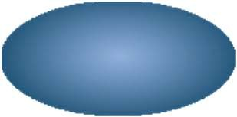












Processes & water usage areas in a thermal power plant
Main Intake Water Reservoir
Coal Handling
Drinking water Supply
(Township & Plant)
Filter House
Raw Water Treatment
Ash Handling System
DM Plant
Ash water recirculation
Fire Fighting
Power Generation Units
Boilers
Ash Dyke
Evaporative + Drift Losses
Steam
Turbines
Makeup Water
Condenser
Cooling Towers IDCT
Feed water
Auxiliary uses
Closed cycle Water Recirculation

Slide 16
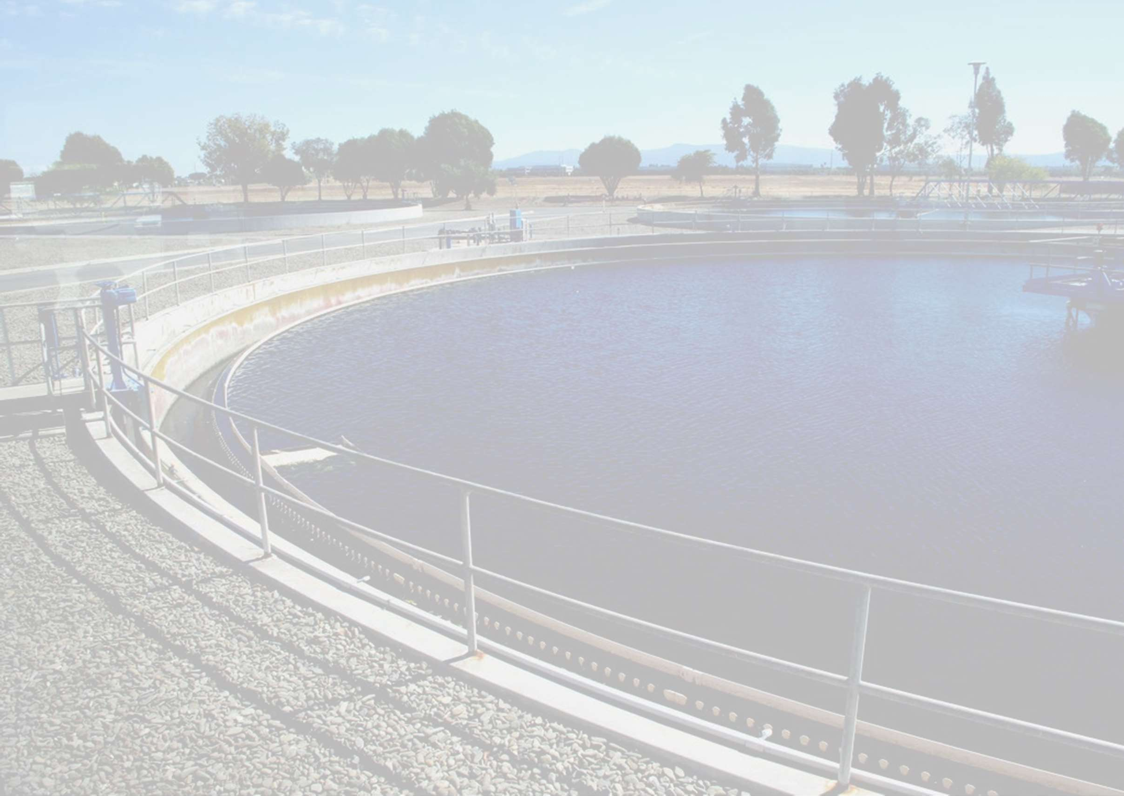
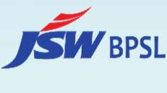
Typical Water Consumption Figures
Plant water consumption is governed by a number of factors such as :
Quality of raw water, type of condenser cooling system, Quality of coal, Ash utilization, Type of ash disposal system, Waste water management aspects etc.
In the past, power stations were designed with water systems having liberal considerations and high design margins.
The consumptive water requirement for coal based plants with cooling towers used to be about 7 m3/h per MW
In recent times, plants have been designed with reduced Plant water consumption rate in the range 3.5 - 4 m3/h per MW

Slide 17
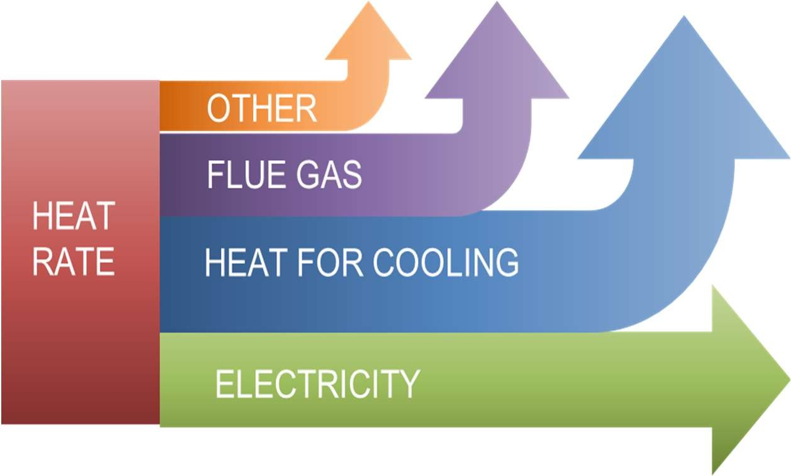
Cooling Water System
Cooling Systems in Practice in India:
Cooling Tower (IDCT / NDCT) – Wet Cooling
Air Cooled Condenser – Dry Cooling
Once Through Cooling – To be replaced as per Dec 7, 2015 Notification

Slide 18

















Dry Cooling System
TURBINE
GENERATOR
CONDENSER
STEAM
FAN
AIR OUT
AIR OUT
AIR IN
AIR IN
CONDESATE
PUMP

Slide 19





Economics of Dry Cooling vs Wet Cooling System
Initial Cost (Rs Crore)
150
120
50
Wet Cooling - IDCT Wet Cooling - NDCT Dry Cooling - ACC
For a typical 660 MW Coal Based TPP
*Considering Steam cycle efficiency as 40%

Slide 20





Space Requirement of Dry Cooling vs Wet Cooling System(NDCT & IDCT)
Foot Print Area (Sq M)
15000
14000
8000
Wet Cooling - IDCT Wet Cooling - NDCT Dry Cooling - ACC
For a typical 660 MW Coal Based TPP
*Considering Steam cycle efficiency as 40%

Slide 21





Power Consumption of Dry Cooling vs Wet Cooling System
Aux. Power Consumption* (KW)
8000
6500
5000
Wet Cooling - IDCT Wet Cooling - NDCT Dry Cooling - ACC
For a typical 660 MW Coal Based TPP
*Considering above plan area.
#CW Pump Power included for IDCT & NDCT.

Slide 22







Water Consumption Comparison of Dry Cooling vs Wet Cooling System
Water Losses as ‘%’ Circulating Water Flow
Evaporation Loss Blowdown Loss Drift Loss
0.05%
0.75%
0.05%
0.75%
1.60%
1.60%
0
IDCT
NDCT ACC
For a typical 660 MW Coal Based TPP
*Considering Steam cycle efficiency as 40% and COC=3.0

Slide 23

Water Conservation Techniques for CW System
Replace Once Through Cooling System with Cooling Towers / Air Cooled Condensers
Implementation of High operating COC (Cycles of Concentration) to reduce the blow-down loss
Increasing COCto 5 from COC=3.0, Blow-downloss willreduce by 50%.
Installation of Air Cooled Condensers

Slide 24


Techno- economics of Dry & Wet Cooling Systems
As compared to wet cooling system, dry condenser cooling system results in reduction of unit output by about 7%
Unit Output (%)
102
100
98
96
94
92
90
88
Unit Output (%)
IDCT
NDCT
ACC

Slide 25
Techno- economics of Dry & Wet Cooling Systems
The heat rate of the unit with dry condenser cooling system is higher by about 7% in accordance with reduced output as indicated.
Heat Rate on ACC
7%
In terms of efficiency, thermal efficiency of the plant shall reduce by about
2.5 percentage points
Plant Thermal efficiency with dry Cooling system
2.5%

Slide 26


Techno- economics of Dry & Wet Cooling Systems
Specific coal consumption of the unit shall increase by about 7%.
Specific coal
consumption with dry Cooling system
7%
Typical CO2 emission from the plant shall also increase by about 7% (from 0.9 kg/kWh to 0.96 kg/kWh) with dry cooling system as compared to wet cooling system.
Specific CO2 emission with dry Cooling system
7%

Slide 27






Techno- economics of Dry & Wet Cooling Systems
For a conventional 500 MW unit, Aux Power Consumption is 6.5 % with IDCT, 6 % with NDCT based CW system and 6.8 % of gross output for plant with direct cooling air cooled condensers
Plant Auxiliary Power Consumption (% of Rated Plant Output)
7
6.8
6.6
6.4
6.2
6
5.8
5.6
Auxiliary Power Consumption (% of Rated Output)
IDCT
NDCT
ACC

Slide 28

Techno- economics of Dry & Wet Cooling Systems
Cost for plant with wet cooling system as ` 5 crore/MW, the cost of the plant with dry cooling system would vary from ` 5.5 to 5.7 crore/MW
Cost of Plant with dry Cooling system
10%
The levelised tariff is expected to increase by about 8- 9% over base levelised tariff for plant with dry Cooling system
Levelised Tariff with dry Cooling system
8-9%

Slide 29



Steam & Water Analysis System-SWAS

Slide 30
















AVGF- Auto Valve less Gravity Filter
AVGF
5-10 %
_{MCW} COOLING TOWER
HOT WATER
COLD WATER CONDENSER
45 m³ BACK WASH WATER RECYCLED
ETP

Slide 31
General Fundamentals
Cooling Tower – A medium for Heat Transfer
The make-up water source is used to replenish water lost by evaporation. In a re-circulating cooling system, concentration of mineral ions in water continuously increases due to water evaporation.
For every 6ºC decrease in temperature across the tower, approximately 1% of the circulation water will be evaporated, thus increasing the dissolved solids content of water in the system.
When the concentrated water is heated inside heat transfer equipment, the calcium and bicarbonate ions precipitate due to the changes in solubility, forming hard scale on the heat transfer surfaces, and clogging pipes and manifolds.
1-degree increase in cooling water temperature can cause a 3% increase in energy usage. Proper maintenance could improve a cooling tower’s efficiency.

Slide 32
General Fundamentals
Common Cooling Tower Problems:
Scaling/Precipitation Fouling:
Mineral based scales that form due to exceeding the saturation point of the scaling species.
Microbiological Fouling or Biofouling:
It may occur from poor or inadequate biocide feed and control.
Deposition/Particulate Fouling (including corrosion products)
Suspended solids such as dirt or corrosion products that settle out in the cooling system.
Goal:
Water is scarce. Thus, there is an imminent need to use water efficiently and treat it within the parameters of environment to make it sustainable.

Slide 33

Scale and Bio-Removal System
SBR is a fully automatic online technology that continuously clean the cooling tower water and augments the cooling performance and treat cooling water without any chemicals.
Electrolysis Chamber
Cooling Tower
Media Filterer

Slide 34

Scale and Bio-Removal System
Electrolysis Based Scale Removal and Prevention with Water Disinfection Process
A DC electrical power source is connected to two electrodes typically made from Platinum with Iridium coated (Anode) and Stainless Steel-316 (Cathode) .
Hydrogen will appear at the cathode (where electrons enter the water), oxygen will appear at the anode.
This electrolytic environment creates a high pH level at the cathode, which causes existing mineral salts in the water to precipitate and stick to the cathodes. This prevents them from depositing on the heat exchange surfaces at other parts of the system in the form of scale.
SCRAPPER

Slide 35

Scale and Bio-Removal System
Due to electrolysis (Cathode and Anodic Reaction) all the TDS (Salts like Calcium, magnesium, Iron) are attracted towards the Cathode(-) and are stick and precipitated to the smooth surface of the Cathode Drum. Deposits are formed due to these salts which are removed in the Cathode drum removed by scrapper mechanism as programmed.
As the water becomes soft the salts are dissolved and the capability of the water to dissolve the salts increases and some precipitation takes places in the drum which is automatically removed during flushing.

Slide 36

SBR Working Principle
Electrolysis works as follows:
Water in the cycle is pumped into the electrolysis chamber.
The water pH level is raised slightly increasing the alkaline environment causes existing mineral salts in the water to precipitate and stick to the cathodes and prevent corrosion.
Cathode (reduction): 2 H2O(l) + 2e− → H2(g) + 2 OH− (aq)
The main ingredients of scale in water systems (Mg(OH)2, CaCO3, MgCO3, SiO2) are almost completely removed from the water in this process.
At Cathode

Slide 37

SBR Working Principle
❖SBR implements electrolysis technology that promotes electro-chlorination and electro- oxidation, delivering superior water treatment results in comparison to chemical treatment.
❖The anode oxidation reaction is a series of reactions that produce gases and free radicals with high oxidation potential that disinfects the water.
❖Due to anodic(+) reaction Free chlorine, Hydrogen Peroxide, Carbon Di-oxide, Ozone, Oxygen is evolved which kills the bacterial growth and kills the algae in the cooling tower. Since the free chlorine is available in the water it will stop the algae growth in the cooling tower.
❖Anode (oxidation): 4 OH− (aq) → O2(g) + 2 H2O(l) + 4 e−
❖ The agglomerated suspended solids removed further with a Sand filter/Disc Filter
At Anode

Slide 38

SBR Working Principle
Disc Filter
The disc filter consists of multiple discs mounted onto a central drum. The woven filter media captures solids and particles, ensuring a continuous flow of clean water.
The innovative backwash cycle optimizes cleaning efficiency.
Made from durable materials like polyester or polypropylene, disc filters have a long service life.
Disc Filter

Slide 39



Blowdown Water Reduction By 50%
SAVE 50% BLOW DOWN WATER
ZERO CHEMICALS
REDUCE STP TREATMENT COST
IMPROVE COOLING TOWER PERFORMANCE
3 x COC
Israel Technology

Slide 40
Advantages Of SBR
Save more than 50% of blowdown water.
SBR allows the operation of the cooling towers at 4500-5000 µs conductivity, saving up to 50% of Blow down water.
Zero chemicals that means Elimination of maintenance, storage and discharge of chemicals.
Environment-friendly.
Reduce operational cost.
Reduces your maintenance downtime.
Enhance cooling system performance.
Low operating costs.
Multiply Cycles of Concentration (COC).
By eliminating the use of chemicals, SBR allows the saving of 100% of bleed-off that can be applied for watering or other uses.

Slide 41







Our Commitments: No harm to People, Environment & Society
Water Security Circularity & Biodiversity
Maintaining zero liquid discharge
39% reduction in specific water consumption to 2.21 m3/tcs by FY30
Adopting digitalisation for better water control and monitoring
Promoting Circular Economy
Focus on ‘Zero waste to Landfill’
‘No net loss’ of Biodiversity by FY30
Increase green cover across operations
Climate Change
Energy Transition
Air Emissions
Targeting Net Zero by 2050
Transition from thermal to RE
PM, SOx and NOx emission targets of 0.26,
0.82 and 0.91 kg/tcs respectively, by FY30
42% reduction of CO₂ to 1.95 tCO₂/tcs by FY30, aligned with India’s NDC’s
19% reduction in specific energy consumption to 5.65 Gcal/tcs by FY30
Adoption of best available technologies like MEROS, Oven Pressure Control, CDQ, TRT etc.
Increased use of scrap in steelmaking
Energy efficiency and process efficiency improvements through BATs
Adoption of disruptive technologies (Green H₂, CCUS, etc.) in a progressive manner
Target reduction for CO2 emissions, specific energy consumption, specific water consumption, specific process dust emissions, SOx and NOx emissions by 2030 is from baseline 2005 levels

Slide 42


THANK YOU
Avinash Ujjwal
8284853388
avinash.ujjwal@jsw.in

